Slide 1
File System Management

Slide 2
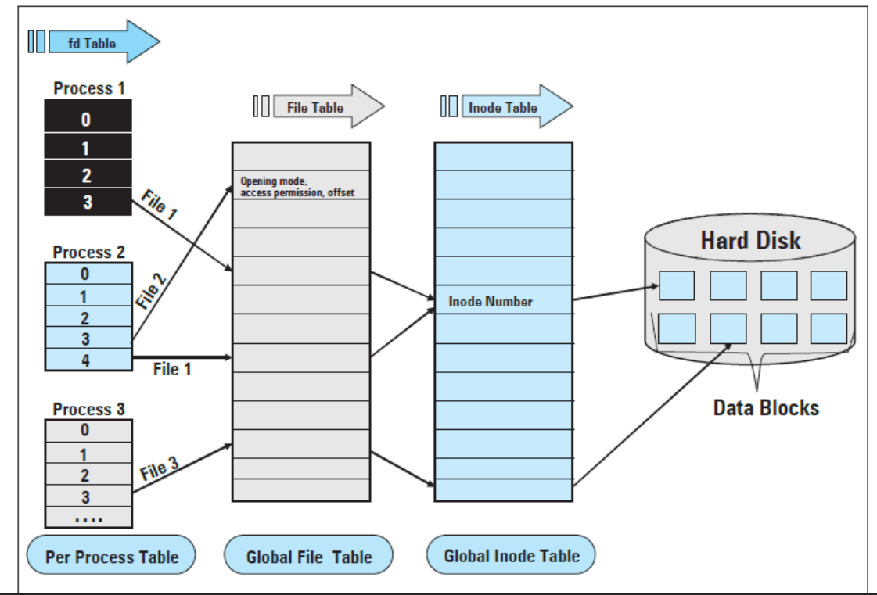
Image courtesy: https://stackoverflow.com/questions/5256599/

Slide 3
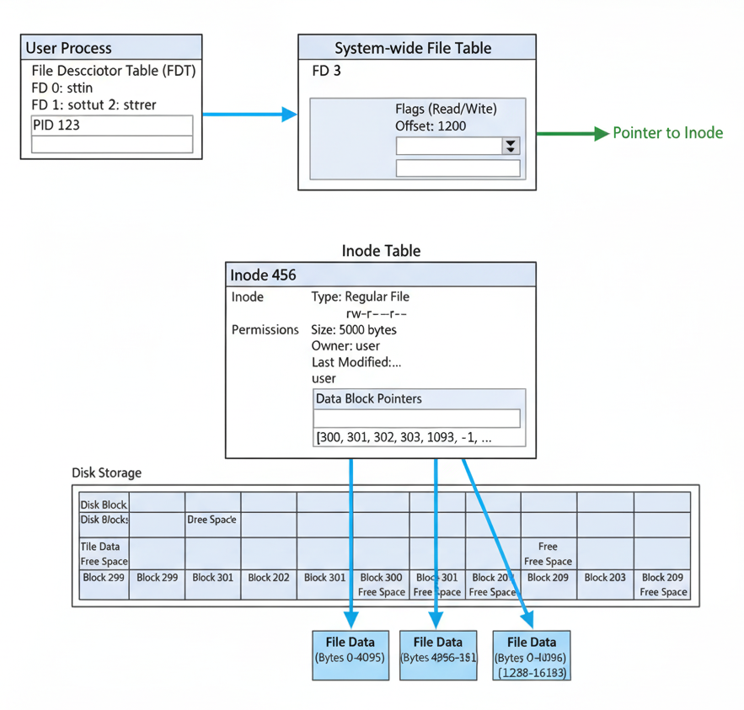

Slide 4
Basics: Hard Disk
A hard disk can store a large volume of data that can be read and written. The data stored is also persistent.
Data Access from Hard disk is not random rather direct
A disk may have multiple platters, with two surfaces per platter. Each surface has concentric tracks and each track are divided into sectors.
Notes:
An SSD stores information in memory chips made of millions of tiny cells called flash memory cells.
Each cell can trap or release electrons — and that’s how it remembers 1s and 0s.
SSD:the electrons stay trapped — thanks to a special insulating layer
RAM: tiny electronic circuits called transistors and capacitors (in DRAM). To keep the data, the RAM must refresh the charge thousands of times per second.

Slide 5
Basics: Hard Disk
Cylinder – collection of all tracks on the different surface that are equidistant from the center.
The read/write heads of hard disk can be positioned on a particular cylinder, and all the sectors on the cylinder can be read/write moving the head (without seek)
The typical size of sector is 512 bytes. The unit of data transfer is a multiple sector.

Slide 6
Basics: File
A file is an abstraction of collection of data (a sequence of bytes)
A file has a name, owner and permission for access
A file system provides facility to organize, store and access files on a disk

Slide 7
File System
A user process need not specify a file by the disk sector numbers or the surface numbers. A set of standard APIs are provided for different file operations.
  Example: an application program, to read n bytes of data from a file, (i) specifies the file name, (ii) data offset within the file and (iii) the number of bytes to read (n), to a system call ‘read()’.

Slide 8
File System
The file system translates the requested file to a logical device number that corresponds to a logical partition of a disk.
The device is an array of blocks to the file system. The requested data from a file is a part of one or more blocks in that array.
Notes:
has a logical device number — a unique ID by which the operating system identifies that partition
Major and minor device number –
major – which device driver should handle this device
Minor – individual device or sub device (partions of the hard disk)

Slide 9
File System
The device driver translates the logical block number(s) to the cylinder, surface and sector number(s) of the hard disk.
Finally, the disk controller gives command to actually read data.
A hard disk may be partitioned in different logical devices (with unique device name and number). There may be different file systems on different logical devices.

Slide 10
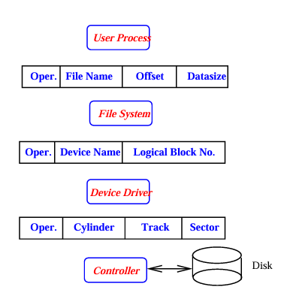
File System
Notes:
using internal tables and Zone Bit Recording (ZBR) logic

Slide 11
File System
File naming - the main purpose of file naming is a unique identification of the object. Most operating systems uses a hierarchical naming system. In Unix/Linux we have:
/, /usr/, /usr/src/, /usr/src/linux-2.4.18-14/, /usr/src/linux-2.4.18-14/README etc.

Slide 12
File System
Directory - a directory is a table containing name and other information about files (or subdirectories) under it.
In Unix/Linux it is treated as a special file. The starting point of the hierarchy is called the root directory.
In Unix/Linux a directory is a file but there are systems that uses file allocation table (FAT).
Notes:
File NameTypeLocation (block/inode)
report.txtFileinode 1203
FAT (File Allocation Table), such as MS-DOS: FAT keeps track of which disk clusters belong to each file.

Slide 13
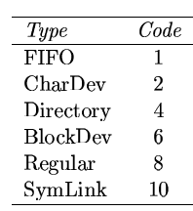
APIs
File system APIs - creat(), open(), read(), write(), lseek(), chmod(), chown(), link(), mknode(), mount(), fifo() etc.
Unix/Linux directory APIs (built on file APIs) are opendir(), closedir(), dirfd(), readdir(), rewinddir(), scandir(), seekdir(), telldir().
Notes:
cat → open() + read() + write()
chardev - terminals, serial ports, sound cards

Slide 14
Virtual File System
It is an OS software layer that provides common interface to different kinds of file systems.
It is an abstract layer between the application program and the implementation of a particular file system.
The common API invokes particular file system function using object oriented approach

Slide 15
File Meta Data
Apart from the information stored in a file, it is necessary to store information about the file in a file system.
Such information are - name, type, size, addresses of data blocks, owner + group ID, access permissions, different dates etc.
This is stored in the index node corresponding to the file

Slide 16
Data blocks
A disk partition may be viewed as an array of blocks. A file may take one or more data blocks for its data. It is necessary allocate blocks to the file and to keep the information as metadata.
  There can be internal fragmentation in a block
Free block list – some of the blocks in a partition of a disk are occupied by different files. Other blocks are free (some of them may be bad). It is necessary to keep the information of the free blocks for future allocation.

Slide 17
File I/O
The smallest unit of data that can be transferred from a disk is a sector; typical size is 512 bytes. It may be different for different disks.
A block device delivers data as a stream of bytes to the device driver, and the number of adjacent bytes transferred by a device driver in a single operation is called a block.
  The block size is a multiple of sector size. Block size may be different for different file systems.
The concept of a page and page frame comes from the memory management system. Typically, a page size is a multiple of a block size.
Notes:
device driver acts as a translator

Slide 18
File I/O
There are two types of disk access
  Block I/O – a block of data is transferred from the disk and stored in a buffer. The block is identified by the major and minor device numbers and the logical block number.
  Page I/O – data is transferred to fill a page frame. There may be more than one non-contiguous block. The data is identified by the inode of a file and offset within it.
Fast access to data – to make data access from the disk fast, a portion of main memory is used as buffer for a block device.

Slide 19
Directory Structure
Single level directory – no logical partition, too many files, unique name for each file.
Two level directory – one master file directory and user file directory for each user. Sharing between two users is difficult.
Tree structured and DAG directory.
Linux hard and soft links

Slide 20
Space Allocation
Allocation time: At the beginning or on demand
Allocation unit size: fixed size, variable size
Allocation of fixed size blocks: contiguous, linked and indexed
Contiguous Allocation
  Fast access to read and write data. Meta data for the data blocks is small.
  All problems of contiguous allocation are present, e.g., the problem of increasing the size of the file on need, external fragmentation, etc.
  First fit or best fit strategies may be used to allocate a new file in the given set of available contiguous blocks.
Notes:
How a file system assigns disk space to files

Slide 21
Space Allocation
Linked Allocation
  A file is a linked list of disc blocks. The directory points to the first block.
  A few bytes (4 or 8) at a fixed position within a block stores the address of the next block. The pointer in the last block is null.

Slide 22
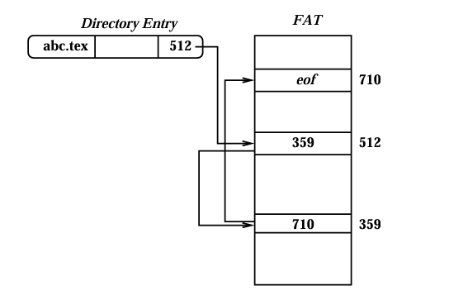
Space Allocation
File access is not direct due to traversal through the linked list of allocated blocks. Access to the furthest blocks is slower.
If there is an error on one link, the file may be lost.
The linked list may be maintained in a table called File Allocation Table (FAT).
  It is indexed by the current block number and holds the address of the next block.
  There is a file allocation table for each partition of the disk.
  The FAT indexes are the block numbers.
  The directory entry for a file points to the first block, and the linked list of blocks is maintained in the FAT.
  The last entry of the FAT corresponding to a file stores an end of file mark.

Slide 23
Space Allocation
If the size of a partition is 200 MB and the size of a block is 4 KB, then there are 200MB/4KB = 50K entries in the FAT.
If each entry is of size 4 bytes, the size of the FAT is 100 KB.
If the page size is 4 KB, 25 pages are required to 'cache' the FAT in the main memory. This makes file access much faster.
Notes:
Each file has an inode that stores metadata and pointers to its data blocks.
The File Allocation Table is a single large table that keeps track of which block comes next for each file

Slide 24
Space Allocation
Indexed Allocation
  One or more disk blocks are used to store the addresses of the data blocks.
  The directory points to the index block.
Notes:
File: report.txt
Directory entry → Index Block 101
Index Block 101 → [Block 5, Block 12, Block 20, Block 33, ...]

Slide 25
Free Disk Block Management
It is necessary to maintain the list of free disc blocks.
  It is necessary to maintain the list of free disc blocks.
  Bit vectors may be used to represent whether a disk block is free.
  A linked list of free disk blocks may also be used.

Slide 26
Index Node (inode)
A file on a disk is identified by its index node (inode) that stores most of the meta-data.
The detail of the inode structure varies for different Unix/Linux file systems.
Following are some of the important meta-data stored in an inode.
  file type and access rights; owner identifier; group identifier
  file length in bytes; number of data blocks; hard link count
  time of last access, time of last change in the inode, time of last change in file
  pointers (direct, singly indirect, doubly indirect and triply indirect - Ext2 etc.) to the data blocks

Slide 27
Inode
For a file system on a particular partition of the disk there is a fixed number of inodes available. When a new file (or a soft link) is created, a new inode is assigned to it.
When a file is opened, different kernel data structures are used to access it, including the per-process file descriptor table, the global file table, and the in-memory inode table.

Slide 28
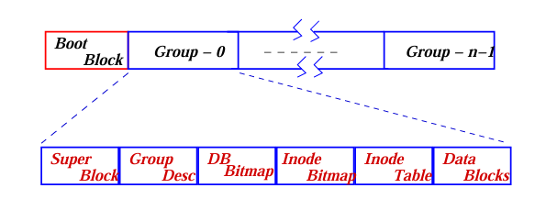
Ext2 file system
Linux Native File System
  Minix file system
  Extended File System
  Second extended file system Ext2
  Third Extended files system Ext3
Notes:
Journaling is a file system feature where changes to the file system are first recorded in a special log called a “journal” before being actually applied to the disk.
It's reserved for the boot loader code, which is essential for initiating the operating system when the computer starts.
Super Block: Contains critical information about the entire file system (e.g., total number of blocks, block size, number of inodes, file system state)
Group Descriptor (Group Desc): Stores information specific to that particular Block Group (e.g., the block address of the inode bitmap, data block bitmap, and inode table for this group).
Data Block Bitmap ($DB_{Bitmap}$): A map of bits where each bit represents a Data Block in this group. A bit set to '1' means the data block is in use, and '0' means it's free.
Inode Bitmap ($Inode_{Bitmap}$): Similar to the Data Block Bitmap, but each bit represents an Inode in this group. It tracks which inodes are allocated (in use) and which are free.
Inode Table ($Inode_{Table}$): A table containing the actual inodes.

Slide 29
Take Away
System Calls & Threads
Hardware Interface – GPR, CR & Interrupt
CPU Scheduling & Inter Process Communication
Process Synchronization
Memory allocation – buddy system
Paging and memory mapping
File system

Slide 30
Thank you!
Even if our paths do not cross at IITH again, the world is not that big — we will surely meet again.
Until then, keep learning and stay curious.

