Slide 1
Memory Management

Slide 2
Previous Class
Memory management for a process
Memory allocation
Contiguous allocation: Buddy system
Bit vector to manage holes

Slide 3
Memory Management: Paging
Two primary techniques
Paging
Segmentation
Paging divides the logical space in fixed size blocks
Segmentation divide the address space based on the semantics – the natural partition of the process image
Notes:
Private data, shared data
User code, library code

Slide 4
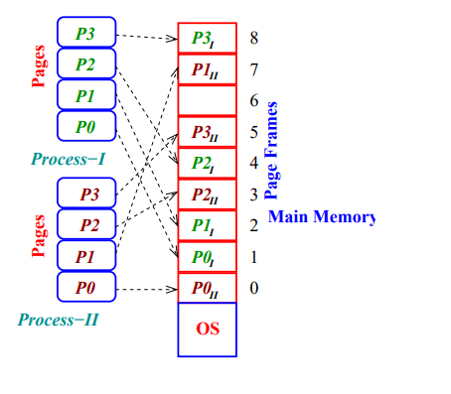
Paging
Example
Size of the main memory = 16MB
Size of data + code = 122KB
Size of page = 4KB
Total Number of page frames = ?
The code will occupy = ?
Internal Fragmentation: Some memory space within last frame is wasted
The last page frame (30th) is not full
Notes:
The size of page frame depends on several factors – the size of disk block, the time taken to transfer a disk block from disk to main memory

Slide 5

Paging
For each process, a table is used to translate virtual/logical address to physical/main memory address
A logical address has 2 parts
Index of the page table
Notes:
Page number in a book and offset is the line in the page

Slide 6
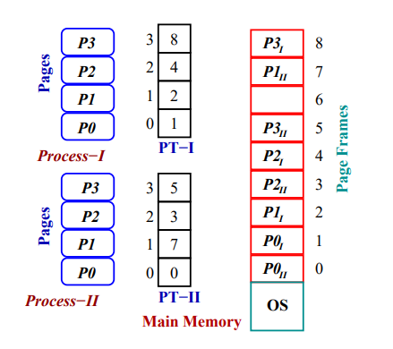
Page Table
Questions
What is the size of the Page Table?
Depends on virtual address size, page size & size of each page table entry
In 32-bit system, 4 KB page size, 4-byte PTE – what should be the PT size?
Where does the OS store the page table?
Page tables are kept in RAM
CR3 holds the physical address
Notes:
2^20*4 byte = 4MB

Slide 7
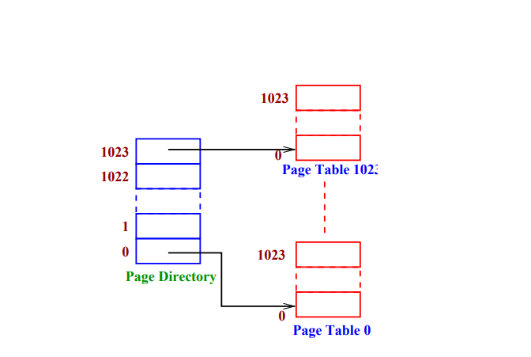
Page Directory

Slide 8
Page Directory
31 22 | 21 12 | 11 0
PT-Directory | P-Table Offset | P-offset

Slide 9
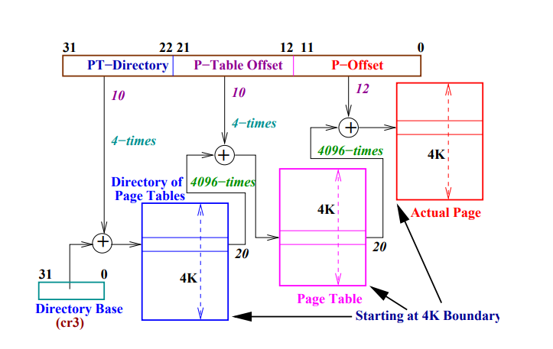
2-level page translation
0th bit is present/valid bit
6th bit is dirty bit – whether the page in the disk is stale
Permission bits
Access privilege bit
Notes:
Entry 0 → offset = 0 → ends in 00 (VA = 0x00003004)
Entry 1 → offset = 4 → ends in 100
Entry 2 → offset = 8 → ends in 1000
Entry 3 → offset = 12 → ends in 1100
31 12 11 9 8 7 6 5 4 3 2 1 0
+------------------------------+----+-------------------+
| Physical Frame Number | AVL|G |0 |D |A CWT RW U P|

Slide 10
2-level page translation
Issues
Every logical address will give rise to 3 access to the physical memory
Notes:
Entry 0 → offset = 0 → ends in 00
Entry 1 → offset = 4 → ends in 100
Entry 2 → offset = 8 → ends in 1000
Entry 3 → offset = 12 → ends in 1100
31 12 11 9 8 7 6 5 4 3 2 1 0
+------------------------------+----+-------------------+
| Physical Frame Number | AVL|G |0 |D |A CWT RW U P|

Slide 11
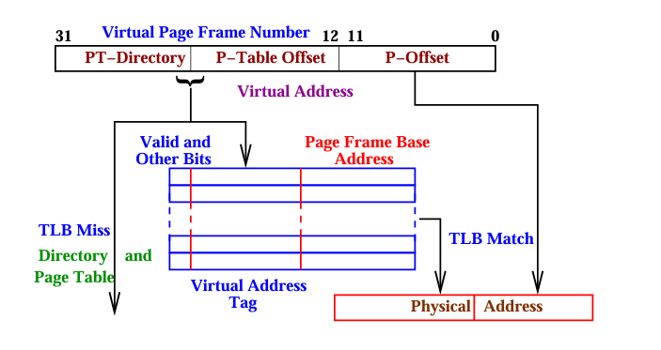
Translation Look-aside Buffer (TLB)
Notes:
Usually 16 to 128 entries

Slide 12
Inverted page table
Notes:
Instead of per process page table, a global page table is created for all process – called inverted page table pid hash function with page number

Slide 13
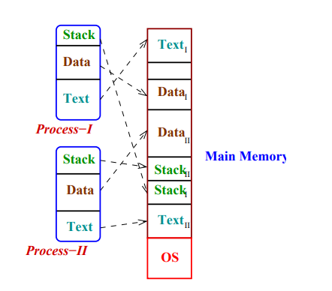
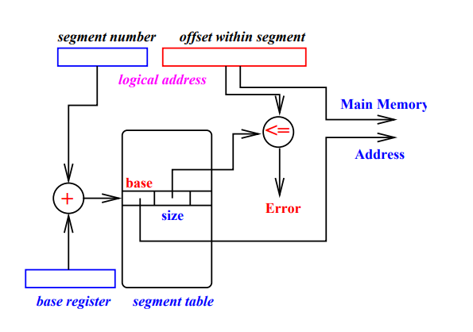
Segmentation
Notes:
Segment table base register Each segment may be viewed as logical space – starting from address 0 (segment base register) to certain value(segment limit register)

Slide 14
Virtual Memory
In ordinary paged memory management – the process image is broken into pages and mapped to page frames. The whole image is loaded for execution
Loading all pages of a large process results an under utilization of main memory
A portion of the disk can be treated as part of the process space (virtual memory). Part of the memory image of a process can be kept in this part – called swap area.
Only the recently used data and text pages are kept in main memory. Rest are loaded on demand
If no page frame is free, old pages need to be swapped out to swap space and accommodate incoming page

Slide 15
Virtual Memory
The disk access is much costlier than main memory access
The system works on locality of reference. New pages are not required often. The working set of process change very slowly
How OS know ff a page is not present in the main memory?
Present/absent bit in page table or page directory entry
Page fault- internal and non-maskable interrupt

Slide 16
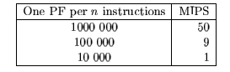
Assume a machine can execute 100 MIPS
Time taken to load a page from disk to RAM takes 10ms

Slide 17
Page fault
A valid page may not be present in main memory due to
The page is not been address so far
Page has been swapped out
Solution page replacement algorithms
New page has to be brought in and no page frame is free
How do you know a page replacement algorithm is better than another
Page replacement algorithm A1 is said to be better than another algorithm A2 if number of page fault by A1 is less than that of A2
Notes:
Page fault may happen due to the page is not present in the memory or the due to access right

Slide 18
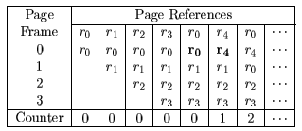
Page replacement Algorithm
Optimal page replacement
Random page replacement
FIFO
LRU
Clock-algo

Slide 19
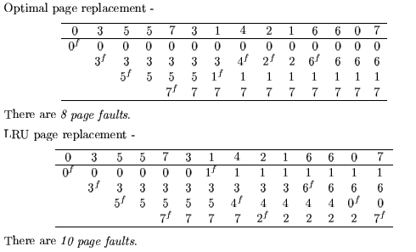
Example

Slide 20
Next Class
File System Management

