Slide 1
System Call & Hardware Interface
OS -1 (CS3510)

Slide 2
Previous Class
An OS is
An interface between the hardware (instruction set architecture ISA) and the application software (application binary interface ABI)
A resource manager – manages resources among different users and computations
A creator of virtual machine – creates an illusion of more resources that this is physically present

Slide 3
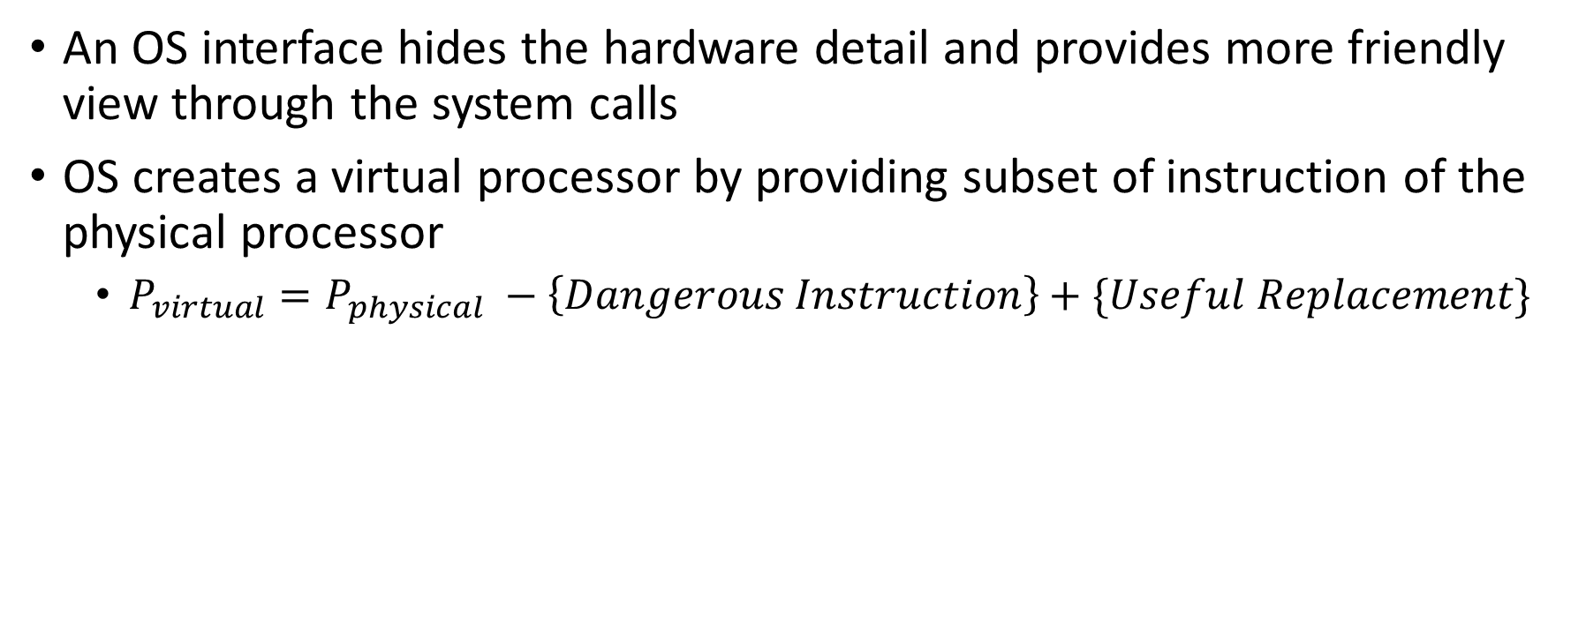
Previous class
An OS interface hides the hardware detail and provides more friendly view through the system calls
OS creates a virtual processor by providing subset of instruction of the physical processor
$P_{virtual}=P_{physical} −\left\{Dangerous Instruction\right\}+\{Useful Replacement\}$
Instruction to control I/O, memory, CPU states etc
OS provides pseudo instruction corresponding to the prohibited instruction through system call

Slide 4
Previous class
Virtual Memory
A process, a unit of computation, is given a memory space called the virtual memory space
It is mapped to parts of physical memory and disk
Virtual I/O
OS hides the complexity of programming an I/O device controller and provides simple system call interface to the application program
I/O devices are treated as files in Unix, and a process with proper capability can access these files

Slide 5
Virtual Address Space
Logical Address space
Stack (↓)
Unused logical address space
Dynamic Data (↑)
Static Data
Code
Physical Address space
Stack
Dynamic Data
Static Data
Code
Why this design?
Efficient use of logical/virtual address space – single contiguous allocation
Protection and error detection – os can easily detect stack overflow and heap corruption
Hardware and compiler convention
Higher Address
Lower Address

Slide 6
System Call
read() and write() system call in Linux
Manual page
read - read from a file descriptor
#include <unistd.h>
ssize_t read(int fd, void *buf, size_t count);
write - write to a file descriptor
#include <unistd.h>
ssize_t write(int fd, const void *buf, size_t count);
Notes:
Looks up fd in your process’s kernel file table
Finds the file object (in kernel memory)
Finds where the file’s data is stored (e.g., disk blocks)
Reads from disk into a kernel buffer
Copies that data into your user buffer (in RAM)
Characters are sent to a terminal device driver, which writes to the screen buffer or serial output.

Slide 7
A small program
#include <unistd.h>
#define MAX 1000
int main () {
char buff[MAX];
read(0, buff, 50);
buff[50]=‘\0’;
write(1, buff, 50);
return 0;
}
// File descriptor 0 for STDIN
// File descriptor 1 for STDIN

Slide 8
Few Other System Calls
open (), create(), close(), lseek()
fork (), clone(), waitpid()
Exec()
dup(), dup(2), …
Using Assembly Language in Linux

Slide 9
System Call | Description
open() | Open a file and return a file descriptor
creat() | Create a new file (deprecated; use open with O_CREAT)
close() | Close a file descriptor
lseek() | Reposition the read/write offset of a file descriptor
fork() | Create a new process by duplicating the calling process
clone() | Create a new process or thread with fine-grained control
waitpid() | Wait for a child process to finish or change state
exec*() | Replace current process image with a new program
dup() | Duplicate an existing file descriptor
dup2() | Duplicate a file descriptor to a specific descriptor
dup3() | Duplicate a file descriptor with flags

Slide 10
Formal definition of system call
A user process send request to the OS for service. The essential component of the request is a set of machine instruction called system call.
int 0x80 -is a machine instruction on x86 processors that triggers a software interrupt
What is a machine instruction?
A machine instruction is a command that the CPU hardware understands directly — part of its Instruction Set Architecture (ISA).
Notes:
the reason it’s called a set of machine instructions is that only the CPU can perform the mode switch that allows access to kernel services

Slide 11
ssize_t read(int fd, void *buf, size_t count) {
return syscall(SYS_read, fd, buf, count);
}
mov rax, 0 ; syscall no. (read)
mov rdi, fd ; arg1
mov rsi, buf ; arg2
mov rdx, n ; arg3
syscall

Slide 12
Interrupt, system call, trap, signal
Trap: any kind of control transfer to the OS is trap
Exceptions: program‐initiated control transfer from user to the OS in response to an exceptional event
Example: divide by zero, TLB miss, page fault
Signal: software version of the exception, triggered by some process/user/OS
Example: SIGFPE, SIGKILL
User/Program Write()
OS
Hardware Timer, I/O complete
System call
Interrupt
Trap
System call
Exception
Signal
nobody agrees on these terms*

Slide 13
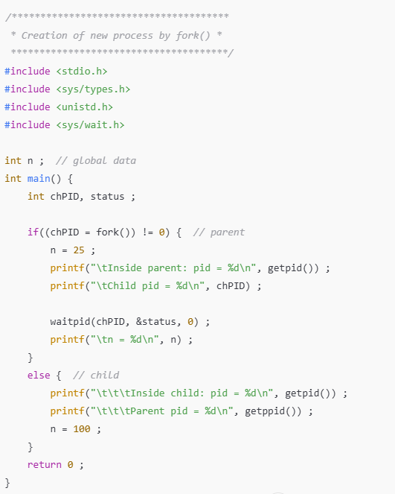
Creation of new process by fork()

Slide 14
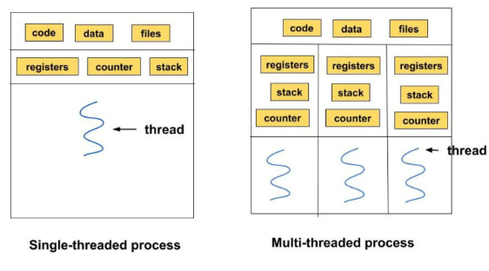
thread()
A thread (of execution) is a sequence of control flow within a process. So far, all the programs we have written runs under Linux as a process with a single thread. But it is possible to create more than one thread of execution within a process.
Different threads have different virtual CPU and stack, but have the same global data area, file descriptors etc.
Creation of a process in Linux - clone() This call allows the child process to share parts of its execution context with the calling process, such as the memory space, the table of file descriptors etc.
clone() is used to implement threads within a process that may run concurrently, and can share the data memory.
Notes:
How about heap and address space?

Slide 15
inc() & dec() using thread

Slide 16
User Process (system call)
Current Process State are saved
CPU moves to kernel/privilege mode
Interrupt Service
Return from interrupt
Restore and continue execution of the normal process

