Slide 1

Operating System I
CS3510

Slide 2
Why should I Study Operating System?
Requirement: It is part of your course — essential to pass the exam & score well
Foundational Knowledge: Provides a systematic understanding of how computer systems operate
System Interaction: Explains the mechanisms through which software applications interface with hardware resources.
Relevance in Contemporary Context: Some may feel OS is “less useful in the AI era”
Even though AI dominates the narrative today, the infrastructure that makes AI possible is still grounded in OS principles. Without the OS, AI cannot practically run at scale.

Slide 3
Why should I Study Operating System?
Scenario: You join an AI-focused company.
Your first project: Deploy a Deep Learning model with latency < 1 ms
Challenges & Solutions:
Software Perspective:
Optimize training and inference pipelines
Use deployment frameworks (e.g., ONNX)
Hardware Perspective:
Efficient use of CPUs, GPUs, and specialized accelerators
Manage memory, threads, and device coordination
Think about SDK sitting on top of Trainium & Inferentia
Notes:
Open Neural Network Exchange DGX2 – low level hardware , NV switch
AWS Annapurna labs, Neuron team (library)
Efficient System calls
OS has two part – user layer, kernal layer
Distributed data transfer – optimize at the kernal level

Slide 4
If you are convinced!
Learn Operating System I - the basic foundation of knowing systems to do more with less
Instructor – Sandipan Dandapat
Office hour – Tuesday 2:30pm to 4pm
TAs: Amruth, Lokendra, Mayank, Pavan
{cs24mtech11007, cs24mtech11024, cs25mtech11029, cs24mtech11006}@iith.ac.in

Slide 5
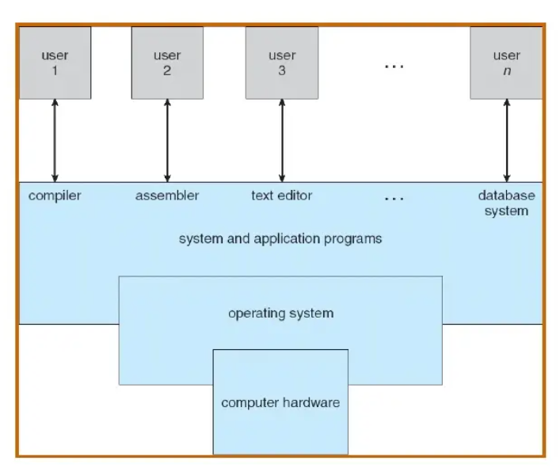
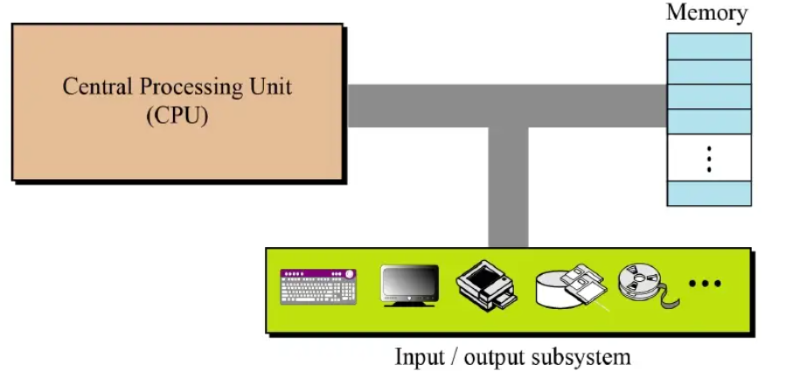
Know your computer

Slide 6
Course coverage
What is OS? (1)
System Call and ISA (2)
Process and Threads (2)
Memory Management (2)
I/O (1)

Slide 7

Know your instructor!
DCU
[2009-2012]
PhD
IIT Guwahati
[2013-2014]
Assistant Professor
Xerox Research [2013-2014]
Research Scientist
Microsoft R&D [2016-2025]
Principal Applied Researcher
IIT Hyderabad [2025 – till now]
Associate Professor

Slide 8
Important Logistics: Admin
Teaching Hours (Room ): LHC-4
Mondays: 4pm to 5:25pm
Thursdays: 2:30 to 3:55 pm
Course Webpage
https://people.iith.ac.in/sdandapat/teaching.html
Books
Operating Systems: A Design-Oriented Approach by Charles Crowley by McGraw Hill Education, 36th edition, 2019
Operating Systems: Principles and Practice by Thomas Anderson and Michael Dahlin, 2nd Edition, Recursive Books, 2015.
Operating System Concepts by Abraham Silberschatz, Greg Gagne, and Peter B. Galvin, 8/9th Edition, Wiely Publication.

Slide 9

Important Logistics: Grading
Assignments Score (A) in %
Quizzes/Tests Score (Q) in %
Attendance (P) in %: to be taken on random days
Threshold T
Penalty (r)

Slide 10

Do’s and Don’ts
Do’s
Submit your own original work for all assignments and tests.
Engage in collaborative learning outside formal assignments.
Ask questions and seek clarification from instructors or TAs when in doubt.
Participate actively in class discussions and exercises.
Don’ts
Do not copy assignments or test answers from anywhere— this will result in a 0.
Avoid any form of plagiarism .
No mobile phones or electronic distractions during class.
Do not share your submissions with others; both the sharer and the copier will receive a 0.
If found guilty, a note will be sent to the Dean of the Academic Office.

Slide 11
Let’s Begin
What’s Operating System?

Slide 12
What is OS?
An OS is
An interface between the hardware and the application software
Software
Operating System
Hardware

Slide 13
Introduction
An OS is
An interface between the hardware and the application software
In this context,
Hardware – Instruction Set Architecture (ISA)
Software – Application Binary Interface (ABI)
A resource manager – manages resource between different users and computation
A creator of virtual machine – create an illusion of more resources than that is physically present
Applications
Application Binary Interface
Operating Systems
Instruction Set Architecture (ISA)
Processor | Memory | I/O System
Circuit Design, Digital Logic, Design, IC Layout, …
Applications
Operating Systems
Processor | Memory | I/O System
Circuit Design, Digital Logic, Design, IC Layout, …
Notes:
ISA is a conceptual level, sits at the boundary between hardware and software. The set of instruction processor understands – ADD, LOAD , JUMP etc and how software interacts with the hardware
ABI defines how software e interfaces with other software at the binary level. Ensures that compiled programs can run on a given OS and hardware without recompiling.
Hardware – Chef + kitchen
Menu is ISA – Menu (that chef and kitchen can prepare)
ABI – Waiter (take order from the customer and hand over)
Application - user

Slide 14
Instruction Set Architecture
The instruction set of the machine
Accessible CPU, FMU and MMU registers
Other CPU, FMU and MMU visible features
CPU states
Interrupt Structure
DMA
Exceptions
Memory Management
I/O mapping and Addressing
Notes:
FMU is responsible for organizing, storing, retrieving, and protecting files on secondary storage

Slide 15
OS
An OS interface hides the hardware detail and provide a more friendly view through the system call
External and Internal View of OS
The external view of the OS is through its ABI
The internal view is the structure and implementation of the interface on top of the instruction set architecture
Notes:
Term Triggered By Direction Synchronous/Asynchronous Purpose
System Call User program User → Kernel Synchronous Request OS service
Interrupt Hardware Hardware → CPU Asynchronous Notify CPU of external event
Trap Program / CPU CPU → Kernel Synchronous Handle exceptions or special conditions
Signal OS / other process Kernel → Process Asynchronous Notify process of an event
This is how a compiled program interacts with the OS at the binary level.
Includes rules like:
How system calls are made
How function arguments are passed
How data structures are laid out in memory
How the program invokes OS services (file I/O, memory allocation, etc.)
External view means:
As a programmer or application, you don’t care about how the OS is implemented internally.
Internal view = how the OS is actually built on top of the CPU hardware.
It includes:
The kernel structure (monolithic, microkernel, modules)
Data structures, algorithms, and scheduling for processes, memory, I/O
How system calls (defined in the ABI) are actually executed using ISA instructions

Slide 16
Resources Manged by the OS
CPU+FMU+MMU – given to different computations multiplexed in time
Main Memory – partitioned and given to different to different computations. One physical partition may be used by different computations at different time.
Disk may be partitioned for different file systems and under each file system may be portioned for different users
Same I/O device e.g. printer or disk may be used by different computation

Slide 17
Resource Manager
Resource Management calls for protection of one computation from another. OS uses architectural support to protect computation and resources.
Several computation can run on a single computing system. OS create virtual machine for each computation. A computation under an OS that sees a virtual machine is called a process.
More than one threads of computations may share parts of a virtual machine i.e. code and data memory, open files, etc. But they may have other different virtual components e.g., CPU, stack etc.

Slide 18
A Virtual CPU
OS creates a Virtual CPU+FMU+MMU for a process by providing a subset of the instruction of the physical processor
Instruction to control I/O, Memory & CPU states are not available to process as the OS wants to do the resource management
OS provides pseudo instructions corresponding to the prohibited instruction through system calls. A computation request for services from OS through these calls

Slide 19
Different type of system calls
I/O operations
Request for more memory
Request to create a virtual computer (process)
Commination between computations
Synchronization
…

Slide 20
Virtual Memory & I/O
Virtual Memory
A process, an unit of computation, is given a memory space, Called the Virtual Memory space. Its mapped to parts of Physical Memory and also to the disk
Virtual I/O
OS hides the complexity of programming an I/O device controller and provides simple system call interface to the application program
I/O devices are treated as files in Unix, and a process with proper capability can access those files

Slide 21
Next Class
System Calls
Notes:
Memory Layout of C Programs - GeeksforGeeks

Slide 22

Final Mantra
“Theory will take you only so far.”
Notes:
Ernest Lawrence

Slide 23
Theory can only take you so far –

