Slide 1
Querying SQL, NoSQL, and NewSQL databases together and at scale
Bapi Chatterjee
IBM, India Research Lab, New Delhi, India

Slide 2
Disclaimer
The statements/views expressed in the presentation slides are those of the presenter and should not be attributed to IBM in any manner whatsoever.
The definitions, facts, numbers, etc. are true to the best of my knowledge at the time when I retrieved them from their respective original sources.
The presentation does contain contents from external sources and they have been duly acknowledged.

Slide 3

Acknowledgements
Srikanta Bedathur Jagannath
(IBM IRL, New Delhi)

Slide 4
“Big data” in the real world
Consider Patient data in Real world
Demographic
Caregiver Notes
Medical Charts
Lab test results
X-ray , MRI, ETC
<- Tables
Arrays ->
EKG Traces
Blood Oxygen
Blood Pressure
EEG Traces
<-Documents
Time series ->
<- Tables
Time series ->
<- Tables
Arrays ->
<- Images
Source: Tim Mattson, 2015

Slide 5
Poly dB engines
“Poly”Queries
Complex analytics: Compute the FFT over all heartrate waveforms, grouped by patient and day
Real-time decision making in SQL with streaming semantics: Raise an alarm if the heart rate over this window exceeds some threshold
Tables, Time series (RDBMS) - MySQL, PostgreSQL, and Oracle
Documents (Document Store) - Google BigTable, Apache Accumulo, MongoDB
Arrays, Images (Array DBMS) - C-Store, HStore, SciDB, VoltDB, Graphulo

Slide 6
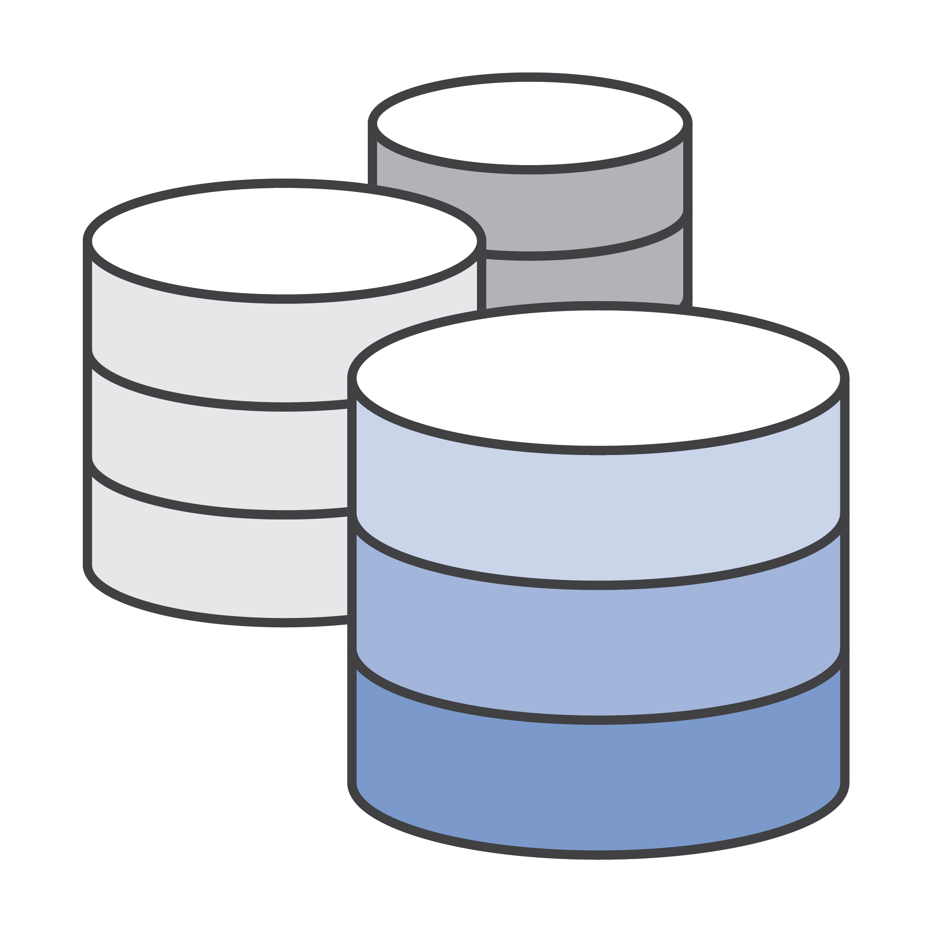
SQL::Nosql::newsql
SQL: Structured Query Language
NoSQL: Not (only) SQL
NewSQL: NoSQL but still SQL

Slide 7
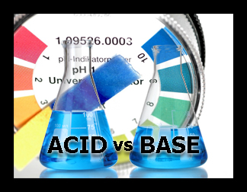
SQL::Nosql
ACID
Atomicity – Either the entire transaction complete or none
Consistency – Any transaction will take the database from one consistent state to another with no broken constraints
Isolation – Changes do not affect other users until committed
Durability – Committed transactions can be recovered in case of system failure
BASE
Basic Availability – Availability first even with partial consistency
Soft State - Do away with consistency
Eventual Consistency – Eventually, converge at a consistent state
(All about liveness, safety is ok to have but not an immediate requirement )

Slide 8
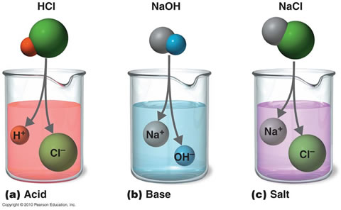
SQL::Nosql::Newsql
 | SQL | NoSQL | NewSQL
Relational | Y | N | Y
Schema-less | N | Y | N
ACID Transactions | Y | N | Y
Horizontal Scalability | N | Y | Y
Performance Big Volume | N | Y | Y

Slide 9
SQL::Nosql::Newsql
Source: Hayden Jananthan et al., 2015

Slide 10
polystore
Describe queries in a common language
Break down the query execution into individual components
Know where datasets are and what they contain
Understand the query execution strength of each engine
Support data transformation if required, but minimize its overheads
Re-write queries into corresponding language
And…deliver performance for complex queries
Source: Srikanta Bedathur et al., 2016

Slide 11
Polystore: BigDAWG
Source: Jeremi Kepner et al., 2016

Slide 12
Polystore: mathematics
PolyAlgebra
Mathematical underpinning for queries in a PolyStore.
To encompass relational, graph, document, spatial, spatio-temporal, etc.
Problem: Discovering a PolyAlgebra.
Problem: Optimizing a Query Language based on a PolyAlgebra.
Source: Jeremi Kepner et al., 2016

Slide 13
Polystore: mathematics
Integrating Data Model: D4M
D4M: Dynamic Distributed Dimensional Data Model.
Foundation of D4M: Associative array.
Provide a generalization of sparse matrices.
Constitute a function between a set of tuples and a value space.
As a data structure, return a value given some number of keys.
In practice, associative arrays support linear algebraic operations such as summation, union, intersection, multiplication and element-wise operations.
Associative arrays have one-to-one relationship with key-value store databases, sparse matrices and adjacency matrices of graphs.
Integrating Data Model: D4M
D4M: Dynamic Distributed Dimensional Data Model.
Foundation of D4M: Associative array.
Provide a generalization of sparse matrices.
Constitute a function between a set of tuples and a value space.
As a data structure, return a value given some number of keys.
In practice, associative arrays support linear algebraic operations such as summation, union, intersection, multiplication and element-wise operations.
Associative arrays have one-to-one relationship with
Source: Jeremi Kepner et al., 2016

Slide 14
Associative Array: Intuition
Associative arrays are generalization of sparse matrices.
Intuitively, an array is an Associative array if each row and column has a unique label.
Source: Jeremi Kepner et al., 2016

Slide 15
Associative array: Construction
Graphs
Adjacency Matrix
Matrices
Straightforward if Boolean
Same as tables, else
Source: Jeremi Kepner et al., 2016

Slide 16
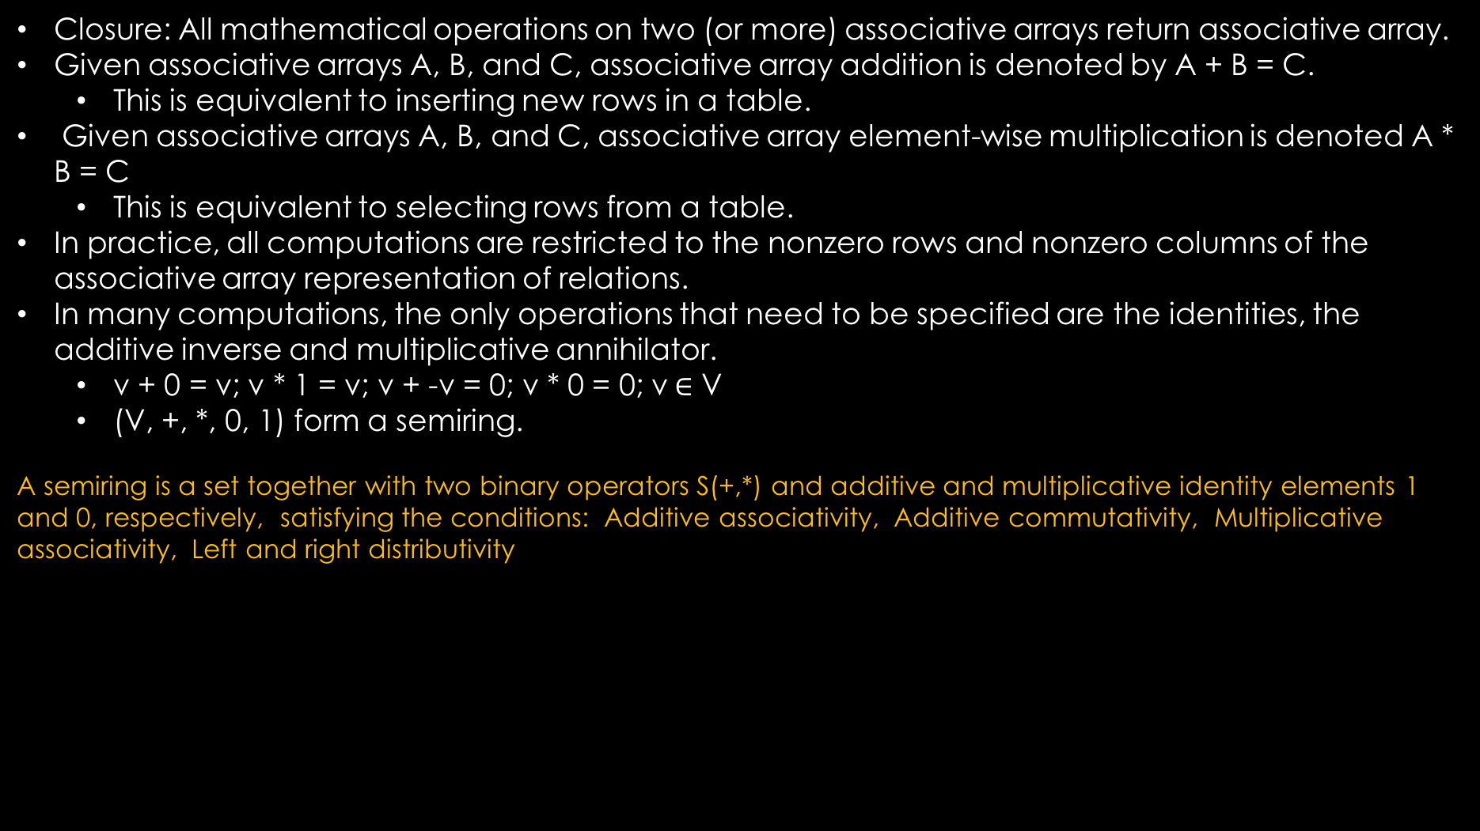
Associative array: mathematics
Closure: All mathematical operations on two (or more) associative arrays return associative array.
Given associative arrays A, B, and C, associative array addition is denoted by A + B = C.
  This is equivalent to inserting new rows in a table.
Given associative arrays A, B, and C, associative array element-wise multiplication is denoted A * B = C
  This is equivalent to selecting rows from a table.
In practice, all computations are restricted to the nonzero rows and nonzero columns of the associative array representation of relations.
In many computations, the only operations that need to be specified are the identities, the additive inverse and multiplicative annihilator.
  v + 0 = v; v * 1 = v; v + -v = 0; v * 0 = 0; v$∈$ V
  (V, +, *, 0, 1) form a semiring.
A semiring is a set together with two binary operators S(+,*) and additive and multiplicative identity elements 1 and 0, respectively, satisfying the conditions: Additive associativity, Additive commutativity, Multiplicative associativity, Left and right distributivity
Integrating Data Model: D4M
D4M: Dynamic Distributed Dimensional Data Model.
Foundation of D4M: Associative array.
Provide a generalization of sparse matrices.
Constitute a function between a set of tuples and a value space.
As a data structure, return a value given some number of keys.
In practice, associative arrays support linear algebraic operations such as summation, union, intersection, multiplication and element-wise operations.
Associative arrays have one-to-one relationship with
Source: Hayden Jananthan et al., 2015

Slide 17
example
Source: Jeremi Kepner et al., 2016

Slide 18
example
Source: Jeremi Kepner et al., 2016

Slide 19
Polystore: Matrix algebra
Source: Jeremi Kepner et al., 2016

Slide 20
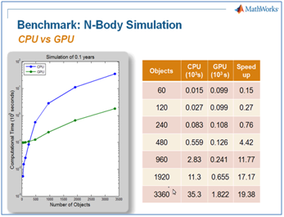
HPC for polystore queries
BLAS: Basic Linear Algebra Subprograms
pMatlab
Matlab-GPU/CUDA

Slide 21
Thank you!

