Slide 1
Algorithmic Architectures for End-to-End Security of Systems: Challenges
RK Shyamasundar
IIT Bombay
rkss@cse.iitb.ac.in

Slide 2
Organization
General: Privacy, Public, Secret, ..
Leakage of Information and Differential Privacy.
Landscape of Map Reduce
  Various attempts
A Novel Approach
  RWFM approach
  End2End Preservation of Privacy in Hadoop: SecHadoop
Summary

Slide 3
Public, Secret, Private
Secret:
  Secrets are things that are not meant to be shared.
  Shared secrets are meant to remain within a well defined group,
  Shared secrets are not meant to be shared outside that group.
Example: Password
  Website cannot afford to keep a password; just check the crypto-hash

Slide 4
Public information
Public information is anything that is meant to be publicly known. There is no risk to anyone’s privacy from you coming to know this.
In public key cryptography
  Public key
  Private key (actually SECRET!)

Slide 5
Private information
Your name is private.
  It is not public information.
  In closed environments such as a corporate office or a conference, your name is meant to be shared within that group, which is why you have to wear a name tag.
An email or WhatsApp message you send to someone is private ( similar to letters).
  Other people cannot see it, unless you or the recipient choose to share it
  Email and WhatsApp forwards are commonplace. They are still private.
    There is no way to tell which piece of fake news is circulating around India on WhatsApp, because it’s private. You can only see what you send and receive.
    Unless it somehow gets published in the media or on a public website, at which point it becomes public.

Slide 6
Where do we place Biometrics
Our biometrics are also private information.
  They are not secrets. You leave a copy of your fingerprints on almost everything you touch. Your iris biometrics can be extracted from a high resolution picture of your face, which even a modern smartphone is capable of. Unless you spend your life wearing gloves and shades, there is no hope of your biometrics being secret. They are available to the people you encounter in daily life, just like your name is.
Unlike your name, other people have no use for your biometrics and don’t pay attention to them, so we may be fooled into thinking they are secrets. They are not.
Biometrics are not public either. There is no public database from which biometrics can be freely downloaded

Slide 7
What is privacy
Privacy is about the responsible maintenance of private information. This responsibility is hard to define, which is why laws are necessary.

Slide 8
Private versus secret
Yiur Aadhar Number
Biometric Issues
Private,
Neither secret nor public
Biometric Issues:
Biometric matching gives probabilistic, not deterministic answers. That means the scanner will score your match on a scale of 0% to 100%. It cannot give a straightforward ‘yes’ or ‘no’ answer.
Most Biometrics have been broken
Biometric matching gives probabilistic, not deterministic answers. That means the scanner will score your match on a scale of 0% to 100%. It cannot give a straightforward ‘yes’ or ‘no’ answer.
Most Biometrics have been broken

Slide 9
Authority versus authentication
Biometric at say Immigration:
When you arrive at a foreign destination (or a foreigner arrives in India), the immigration official at the counter decides whether to let you in. The fingerprint scanner on the desk informs this official. The official is the authority, not the scanner or some remote server.
Biometric at Aadhaar: Implicit assumption that the official at the bank or mobile company cannot be trusted to certify your identity. The authority is with the Scanner/Server

Slide 10
Differential Privacy
From Catuscia P

Slide 11
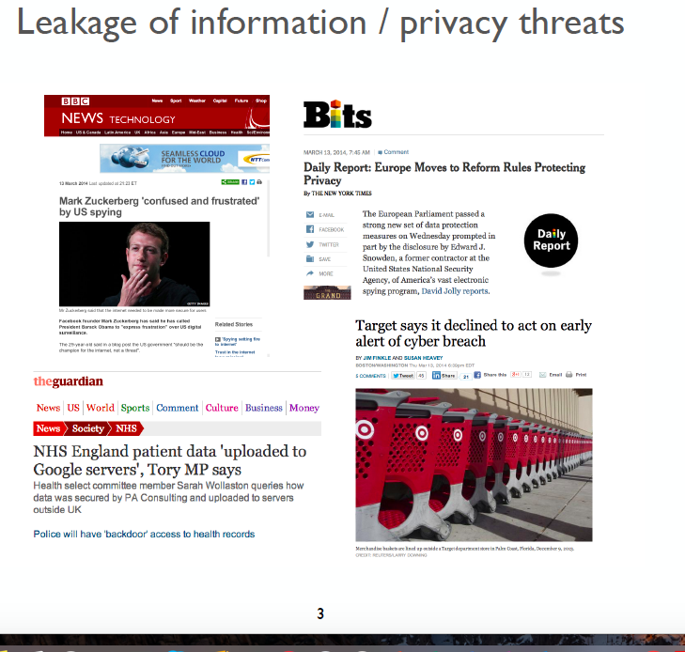

Slide 12
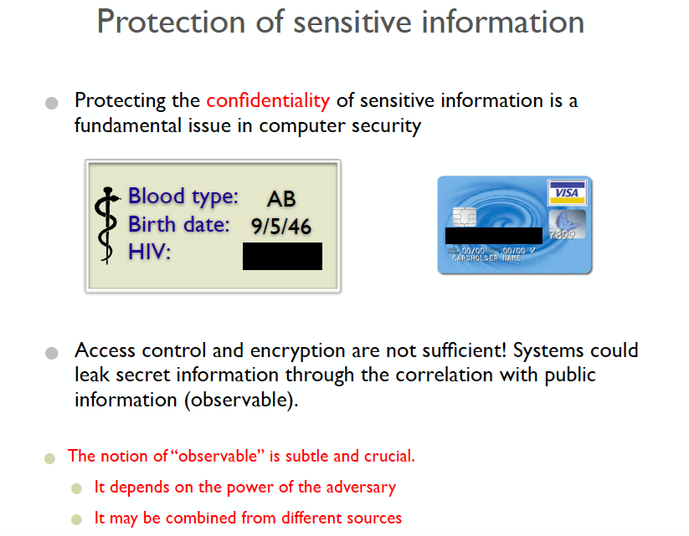

Slide 13
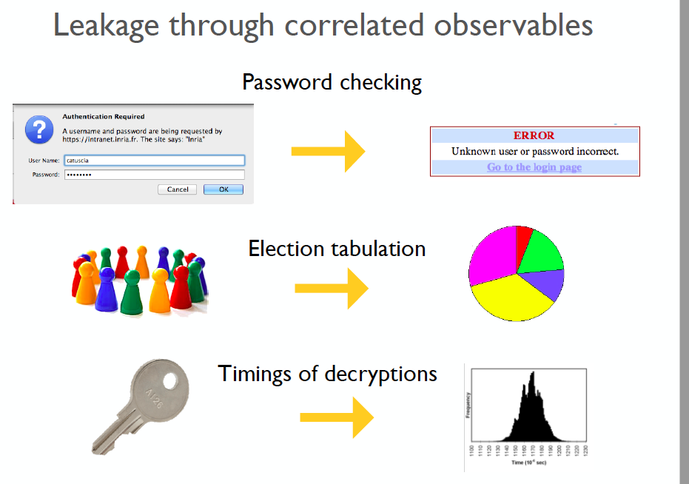

Slide 14
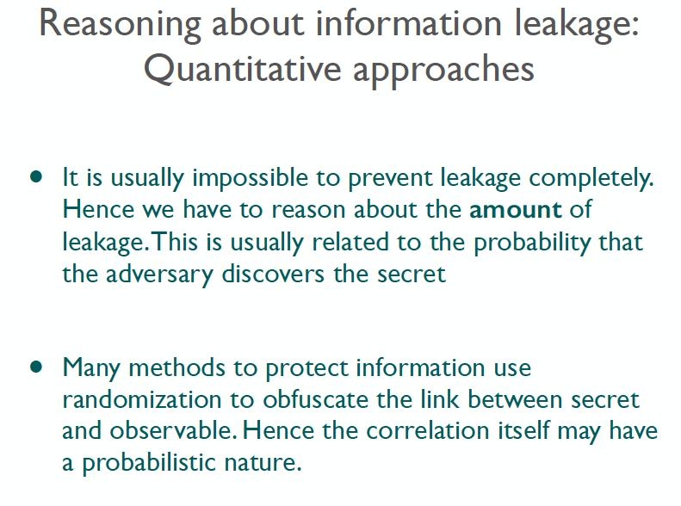

Slide 15
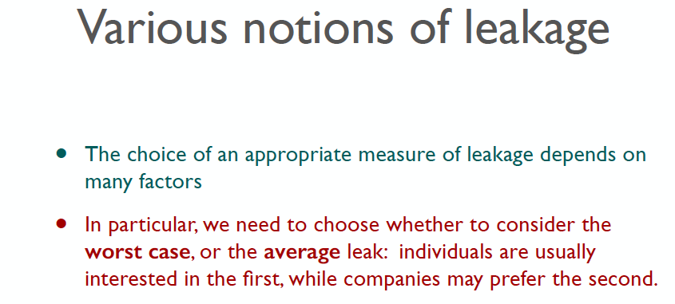

Slide 16
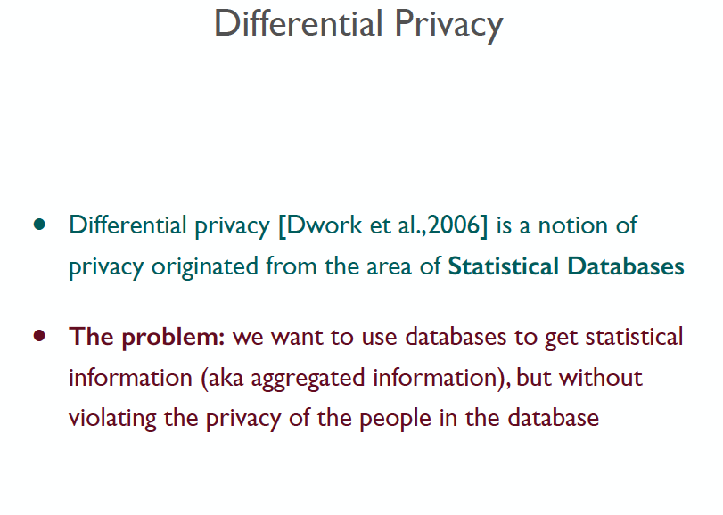

Slide 17
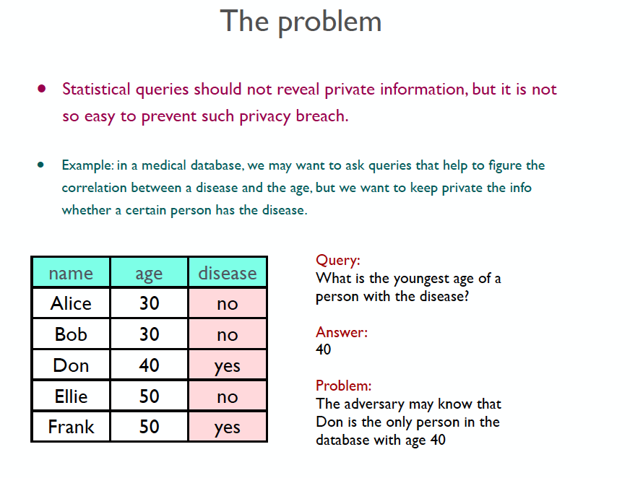

Slide 18
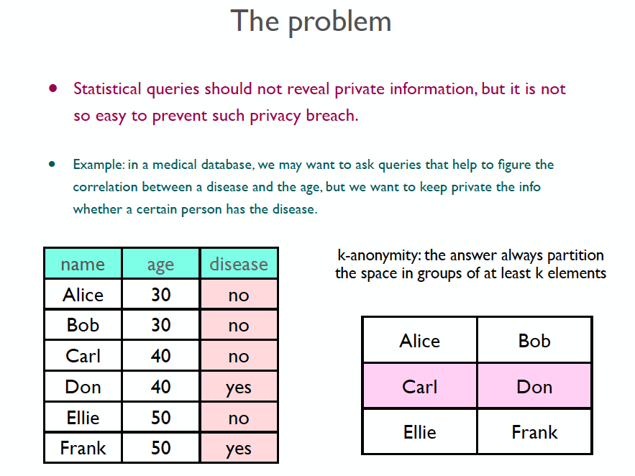

Slide 19
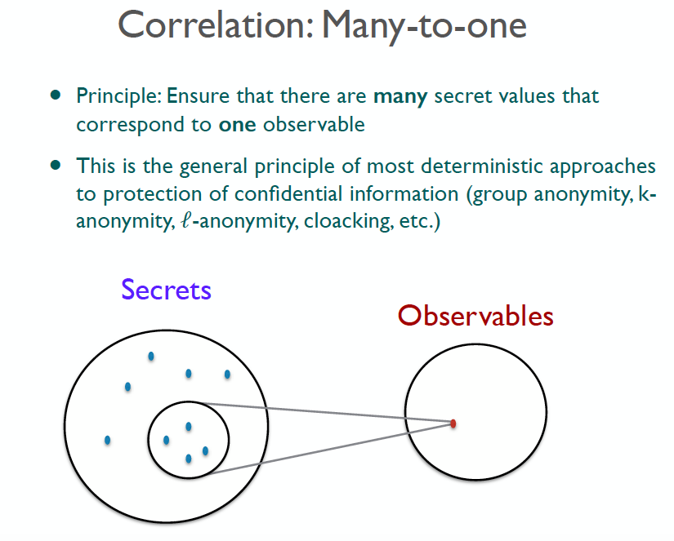

Slide 20
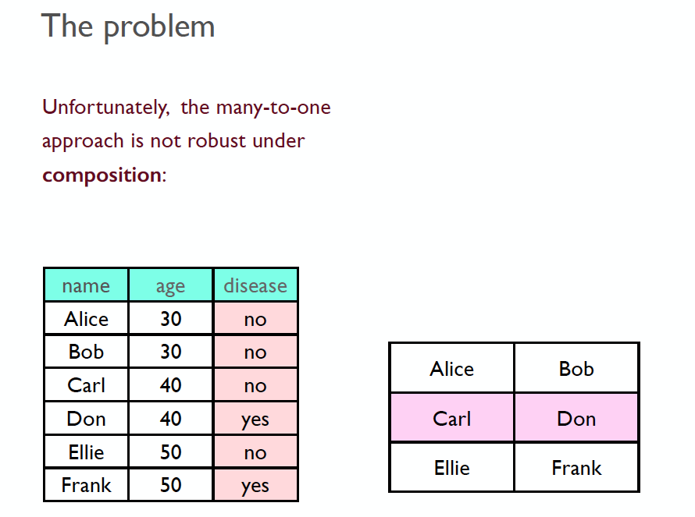

Slide 21
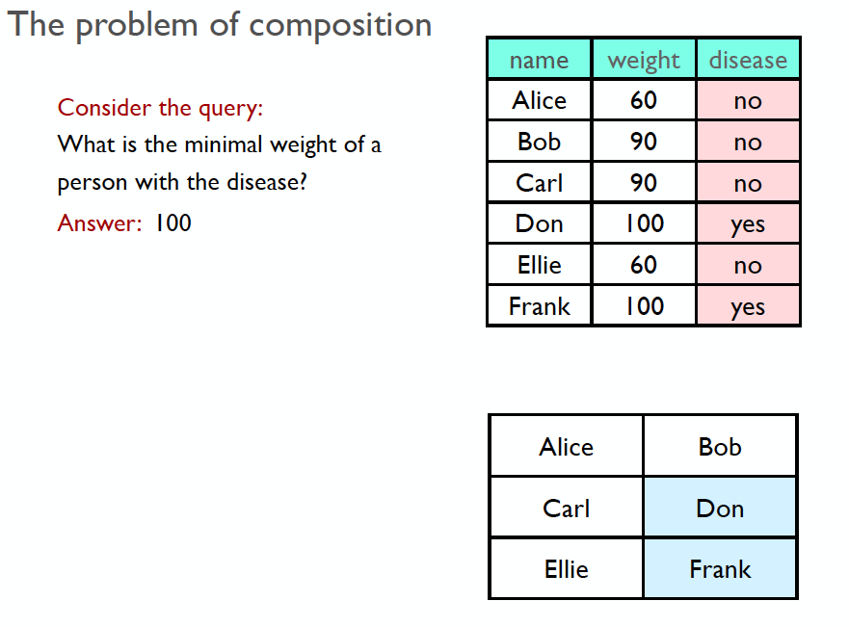

Slide 22
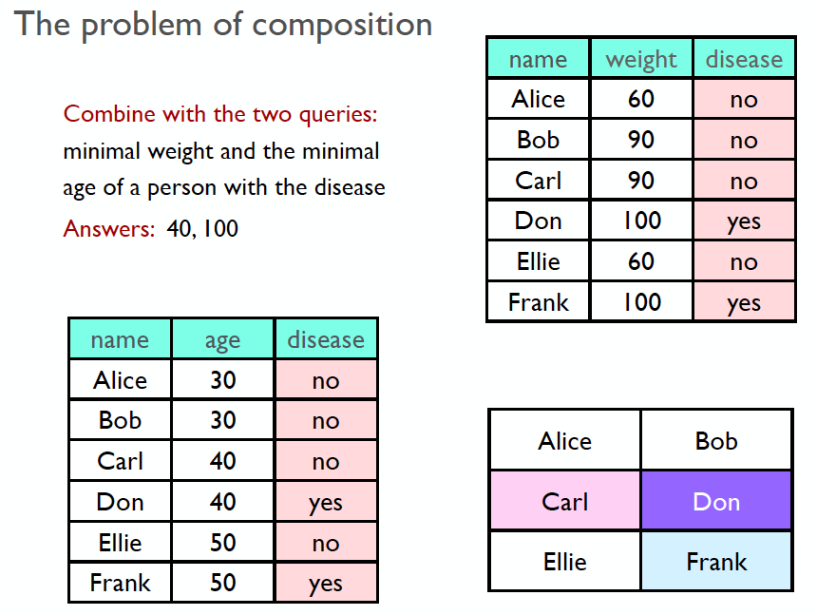

Slide 23
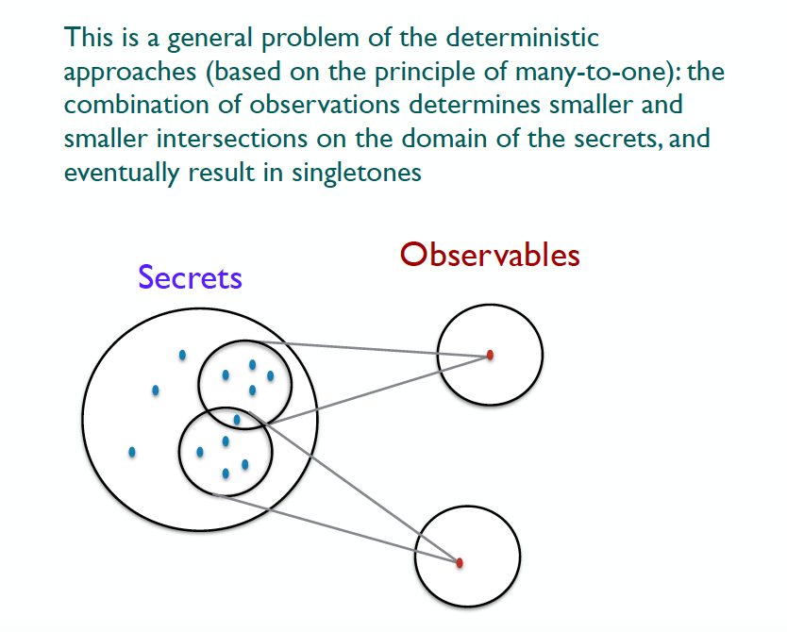

Slide 24
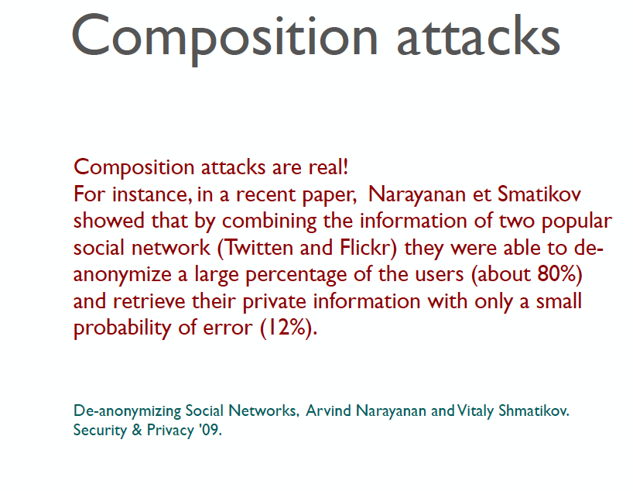

Slide 25
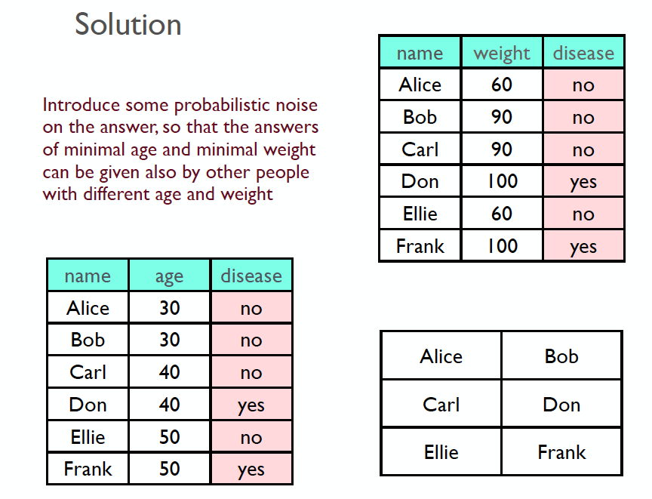

Slide 26
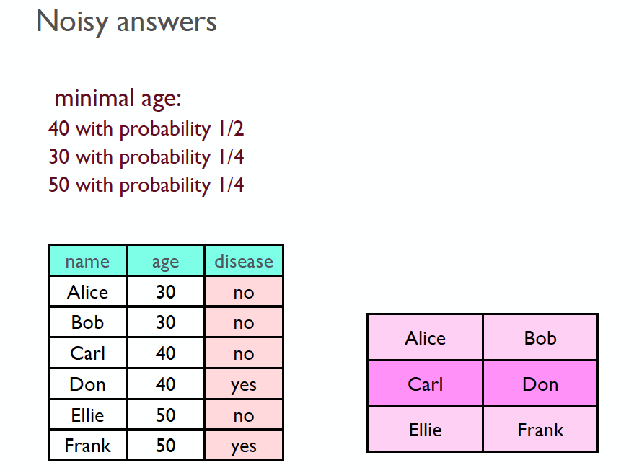

Slide 27
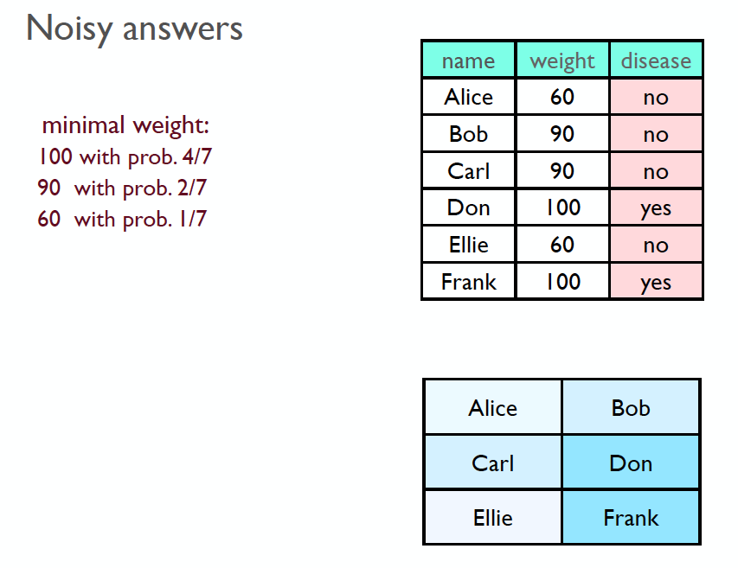

Slide 28
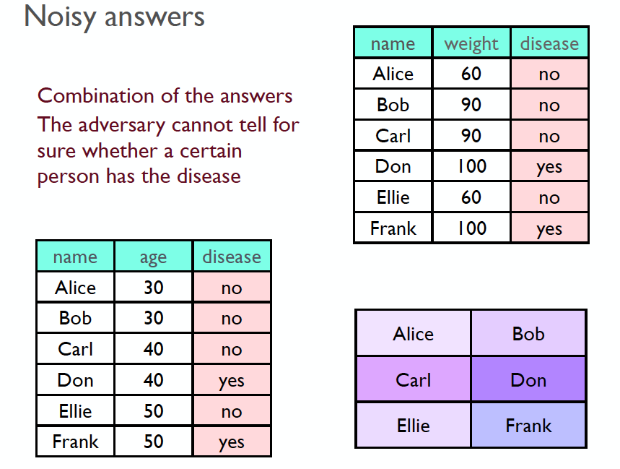

Slide 29
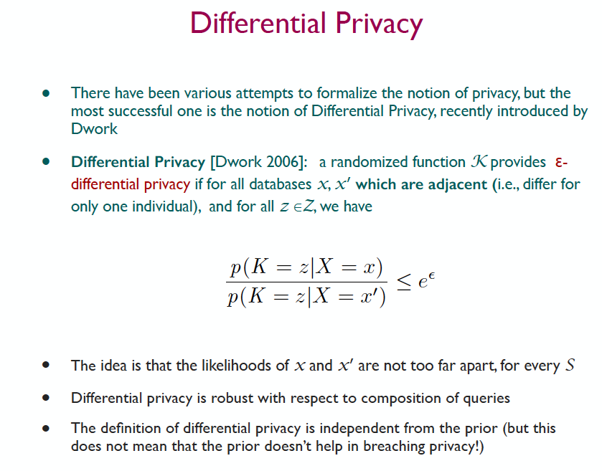

Slide 30
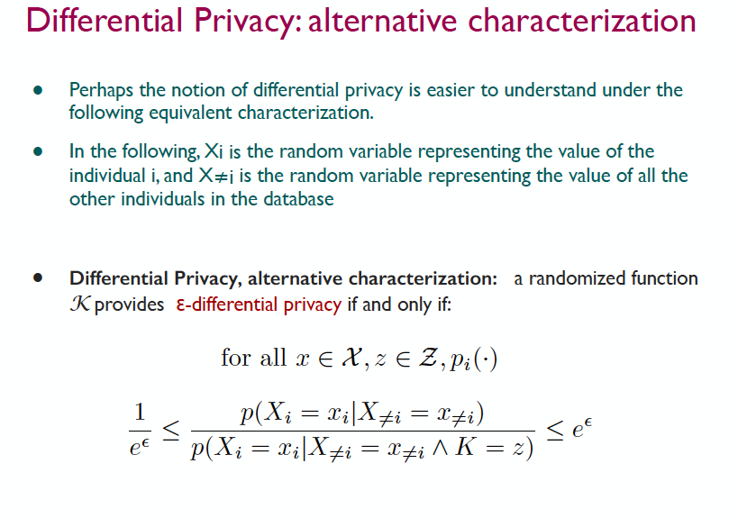

Slide 31
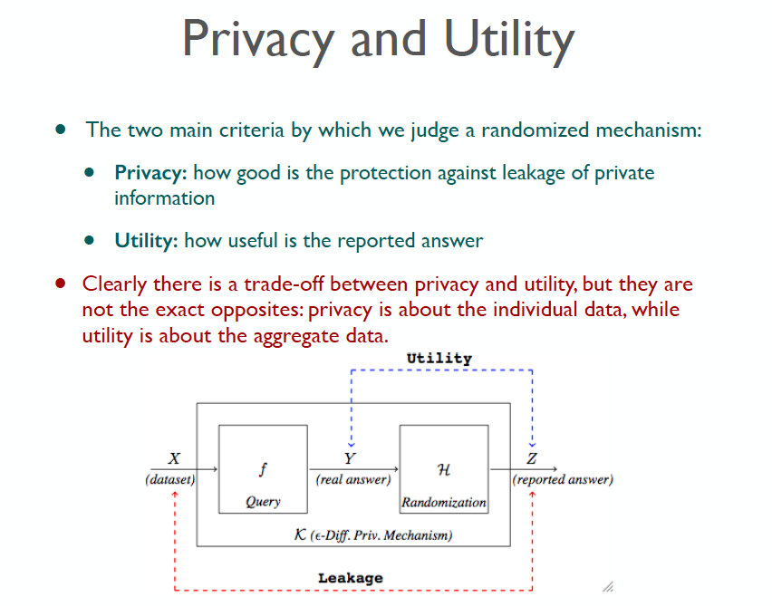

Slide 32
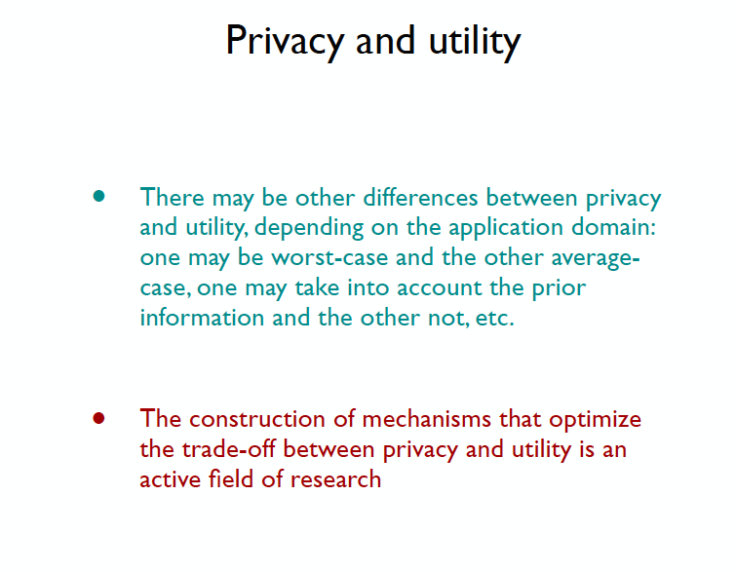

Slide 33
SecHadoop:
End-to-End Privacy
Preserving Hadoop

Slide 34
Motivation
Hadoop: Extensive scalable computations on massive data.
  Achieves through Map-Reduce framework for computation and HDFS for distributed storage of the data.
Privacy concerns arise due to
  data divisions and intermediate data creations that is taking place while the computations are being carried out.
User intervention in job execution in the form of Malware ( or learning) in Hadoop can lead to privacy breaches.
  Naturally requires a robust decentralized information flow control
Secure end-to-end data flow in a Hadoop in a decentralized way preserving the original data privacy invariant
Use such a scheme to protect against
  Learning systems,
  Desensitization of data without any leak,
  Realize Provenance for Neurological data

Slide 35


MAP REDUCE
DATA
OUTPUT
Data mining
Genomic
computation
Social networks
MAP
REDUCE

Slide 36






Impact of Untrusted Program
Information leak?
Untrusted MapReduce program
Output
Data mining
Genomic computation
Social networks
Health Data

Slide 37

Realizing Privacy
Framework for privacy-preserving MapReduce computations with untrusted code.
Untrusted Program
Protected
Data
RWFM

Slide 38
Background: MapReduce
map(k₁,v₁) → list(k₂,v₂)
reduce(k₂, list(v₂)) → list(v₂)
Data 1
Data 2
Data 3
Data 4
Output
Map phase
Reduce phase

Slide 39
Threat model
RWFM encapsulation monitors the computation, and protects the privacy of the data providers
Threat
Computation
provider
2
Data provider
Program
3
Output
RWFM Encapsulation
1
Cloud infrastructure

Slide 40
Challenge 1: Untrusted mapper
Untrusted mapper code copies data, sends it over the network
Peter
Chris
Map
Reduce
Meg
Leaks using system resources
Data

Slide 41
Challenge 2: Untrusted Reducer
Output of the computation is also an information channel
Peter
Chris
Map
Reduce
Meg
Data
Preserve the Privacy of the Original data

Slide 42
Approach 1: Airavat

Slide 43
Airavat*
Airavat = SELinux (fixed set of syntactic labels) + “trusted” reducer + diff. privacy (add noise) -
“reduce” provided by the user – difficult to trust
SELinux ≠ full power of DIFC
Differential policy will be difficult for dynamic evolving data
RWFM = crisp combination of MAC (IFC) + DAC
  Fine-grained labels preserve the privacy including that of the intermediate results without trust assumptions
I. Roy, S. T. V. Setty, A. Kilzer, V. Shmatikov, and E. Witchel. Airavat: Security and privacy for mapreduce. In 7th USENIX NSDI, 2010, pages 297–312.

Slide 44
MLS MapReduce*
MLS MapReduce = SELinux (fixed set of syntactic labels) + different HDFS name nodes (appropriately linked) for different labels
Rigid data storage structure, inefficient solution
RWFM labels more fine-grained – new lattice points generated as appropriate, particularly useful when combining information at different security levels
T. D. Nguyen, M. A. Gondree, J. Khosalim, and C. E. Irvine. Towards a cross-domain mapreduce framework. In IEEE MILCOM, 2013, pages 1436–1441.

Slide 45
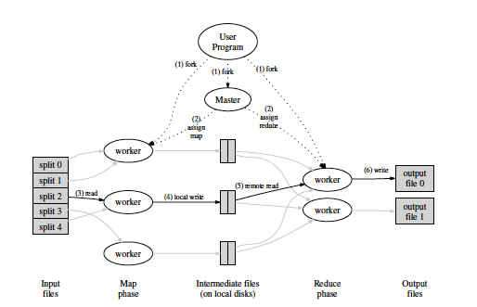
From Dean and Ghemavat

Slide 46
Status of Decentralized
Information Flow Model

Slide 47
Decentralized Label Model
Myers and Liskov (2000)
First model after the seminal Lattice Information Flow model of Dorothy Denning (the lattice defines the flow)
Addresses the weaknesses of earlier approaches to the protection of confidentiality in a system containing untrusted code or users, even in situations of mutual distrust
Allows users to control the flow of their information without imposing the rigid constraints of a traditional MLS
Defines a set of rules that programs must follow in order to avoid leaks of private information
Protects confidentiality for users and groups rather than for a monolithic organization
Introduces a richer notion of declassification
  in the earlier models it was done by a trusted subject; in this model principals can declassify their own data

Slide 48
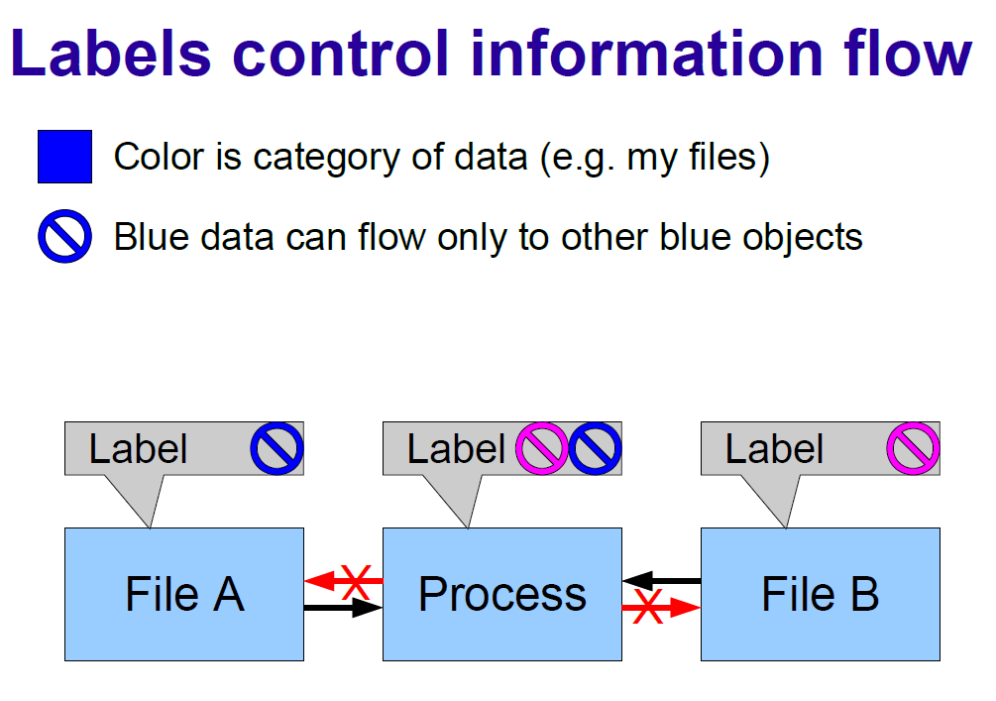

Slide 49
Issues of State-of-the-art (a)
1985 Trusted Computer Systems Evaluation Criteria (Orange Book)
  defines the security of a computer system by how well it implements flow control and how good its assurance is
Despite huge efforts, systems developed had several drawbacks:
  large TCB, slow, not easy to use, and very limited functionality

Slide 50
Issues of State-of-the-art (b)
2000 Myers & Liskov (DLM)
  First Decentralized Label Model after 25 years ( Myers and Liskov) – Cf. B Lampson
  only readers for protecting confidentiality and only writers for protecting integrity
  Issues: for a proper tracking of any information flow property, it is important to control both reading and writing by subjects

Slide 51
Issues of State-of-the-art (c)
HiStar, Flume and Laminar systems
  based on the product of Confidentiality and Integrity
  Issues: confidentiality and integrity are not orthogonal properties and issues of treating Declassification as a DAC
  Fred Schneider, in his book# chapter, clearly brings out the perils of combining confidentiality and integrity policies in this manner
# yet to be published,
available at http://www.cs.cornell.edu/fbs/publications/chptr.MAC.pdf

Slide 52
Issues of State-of-the-art (d)
2012 Mitchell et al. (DC labels)
  not easy to derive consistent DC labels for modelling a given requirement
  Flaw: support for downgrading (discretionary control) is orthogonal to the IFC, thus, defeating the purpose of the mandatory controls
New Robust decentralized Information Flow control model – RWFM ( 2016,2017) – Readers Writers Flow Model

Slide 53
RWFM BASICS

Slide 54
RWFM Model
NV Narendra Kumar and RKs 2016, 2017

Slide 55
Readers-Writers Labels
Security requirements of practical applications are often stated / easily understood in terms of who can read / write information
Observations:
  information readable by s₁ and s_{2,} can-flow-to information readable only by s₁
  information writable only by s_{1,} can-flow-to information writable by s₁ and s₂
Readers and writers can be used as labels!!

Slide 56
RWFM Label Format
(owner/authority, readers, writers)
  First component is a single subject denoting
    owner in case of an object label
    authority in case of a subject label
  Second component is a set of subjects denoting
    permissible readers in case of an object label
    subjects who can read all the objects that this subject can read in case of a subject label
  Third component is a set of subjects denoting
    permissible writers in case of an object label
    subjects who can write all the objects that this subject can write in case of a subject label

Slide 57
State of an Information System
State of an information system is defined as the set of subjects and objects in the system together with their labels. Initial state
  Objects and their labels as required for application
  Each subject s starts with label (s,*,φ)
Whenever a subject tries to perform an operation on an object, it may lead to a state change and will have to be permitted only if deemed safe
  Read
  Write
  Create
  Downgrade
  Relabel

Slide 58
State Transitions in RWFM
Subject s with label (s₁,R₁,W₁) requests read access to an object o with label (s₂,R₂,W₂)
  If s₁∈R₂ then
    relabel s to (s₁,R₁∩R₂,W₁∪W₂) and ALLOW access
  Else
    DENY access
POSSIBLE state change (label of s may change)
s has accessed information accessible only by common members of R₁ and R₂
s can read o
s is influenced by both W₁ and W₂

Slide 59

State Transitions in RWFM
Subject s with label (s₁,R₁,W₁) requests write access to an object o with label (s₂,R₂,W₂)
  If s₁∈W₂ and R₁ R₂ and W₁⊆W₂ then
    ALLOW access
  Else
    DENY access
NO state change
all subjects that can access information in o, can access information s has accessed so far
all subjects that have influenced the current information of s can also influence o
s can write o

Slide 60
State Transitions in RWFM
s, and all subjects that have influenced the current information of s have influenced o
all subjects that can access information accessed by s so far, can access o
Subject s with label (s,R,W) requests creation of an object o
  create an object o and label it (s,R,W∪{s})
DEFINITE state change (a new object is added to the system)

Slide 61
State Transitions in RWFM
s, o and its downgraded version have been influenced by exactly the same set of subjects
Subject s with label (s₁,R₁,W₁) requests an object o with label (s₂,R₂,W₂) to be downgraded to label (s₃,R₃,W₃)
  If s₁∈R₂ and s₁=s₂=s₃ and W₁=W₂=W₃ and R₁=R₂ and R₃ R₂ and R₃-R₂⊆W₂ then
    ALLOW
  Else
    DENY
POSSIBLE state change (label of o may change)
subjects that can access o, can also access all the information s has accessed so far
subjects that could not access o but can access its downgraded version must have influenced information in o
downgrading does not impact ownership
s can read o
all the subjects that can access o can access its downgraded version also

Slide 62

State Transitions in RWFM
s, and all subjects that influenced the current information of s have influenced the relabelling
current information of s has been influenced by all the subjects that influenced o
Subject s with label (s₁,R₁,W₁) requests an object o with label (s₂,R₂,W₂) to be relabelled with (s₃,R₃,W₃)
  If s₁∈R₂ and s₁=s₂=s₃ and W₂⊆W₁ and W₃=W₁∪{s} and R₂ R₁ R₃ then
    ALLOW
  Else
    DENY
POSSIBLE state change (label of o may change)
relabelling does not impact ownership
all subjects that can access the relabelled object, could have accessed all the information that s has accessed so far, and the original object
s can read o

Slide 63
Downgrading (Declassifying)
For practical applications, adding readers (downgrading) to the result of a computation is essential for use by relevant parties
Downgrading rules
  only the owner of information may downgrade it
  if a single source is responsible for the information, then readers that can be added is unrestricted
  if multiple sources influenced the information, then only those who influenced it may be added as readers

Slide 64
RWFM permits intuitive specifications with simple access checks
The above proposition simplifies the access check to s∈R(o) for subject s to read object o and s∈W(o) for subject s to write object o.
Notes:
Note that the simplifications of access checks presented in the above slides only work in the following scenarios:
RW policies derived from a Denning’s policy (i.e. a flow policy) – not all policies that we formulate in practice are flow policies
Subjects and objects are statically labelled

Slide 65
Example-1
WebTax
Bob provides his tax-data to a professional tax preparer, who computes Bob’s final tax form using a private database of rules for minimizing the tax payable and returns the final form to Bob
Security requirements
  Bob requires that his tax-data remains confidential
  Preparer requires that his private database remains confidential

Slide 66
Example-1
WebTax
1
TD^{(B,{B,P},{B})}
1,2
1,2’
IR^{(P,{P},{B,P})}
FF^{(P,{B,P},{B,P})}
2
DB^{(P,{P},{P})}
TD | Tax-data | IR | Intermediate results
DB | Database of tax optimization rules | FF | Final tax form
 | Flows-to |  | Downgraded-to

Slide 67
Example-1
WebTax
 | DLM | DC | RWFM
TD | {B: B} | (B, B) | (B, {B,P}, {B})
DB | {P: P} | (P, P) | (P, {P}, {P})
IR | {B: B; P: P} | (B∧P, B∨P) | (P, {P}, {B,P})
FF | {B: B} | (B, B∨P) | (P, {B,P}, {B,P})
DLM label format: policies separated by ‘;’, where each policy is of the form ‘owner: readers’
DC label format: ‘readers, writers’, where readers control confidentiality, writers control integrity
RWFM label format: ‘owner, readers, writers’

Slide 68
DLM, DC and RWFM Comparison
 | DLM | DC | RWFM
Confidentiality | only Readers | only Readers | Readers and Writers
Integrity | only Writers | only Writers | Readers and Writers
Downgrading (DAC) | Purely discretionary | Purely discretionary | Consistent with IFC (MAC)
Ownership | Explicit | Implicit | Explicit
Authority | Orthogonal to the label | Orthogonal to the label | Explicit in the label

Slide 69
DLM, DC and RWFM Comparison
 | DLM | DC | RWFM
Principal hierarchy and Delegation | Orthogonal to the label | Orthogonal to the label | Embedded in the label
Bi-directional flow | Difficult | Difficult | Simple and Accurate
Ease of use | Moderate | Moderate | Easy
Label size | Moderate to Large | Large | Small
No. of labels | Large | Large | Small (as required by the application)

Slide 70
Labelling Map Reduce
Framework

Slide 71
Flow of a MapReduce Job
Input Data
Job
Input Split 1
Input Split i
Input Split M
Map Task i
Intermediate Data
Output Map 1
Output Map i
Output Map M
P11
P1j
P1R
Pi1
Pij
PiR
PM1
PMj
PMR
Partition 1
Partition j
Partition R
Reduce Task j
Intermediate Data
Output Red 1
Output Red j
Output Red R
Output Data

Slide 72
Flow of a MapReduce Job
The job tracker splits input data, and creates and assigns map tasks
Map tasks execute on slave nodes to produce intermediate results
Job tracker partitions (shuffles and sorts) the intermediate results and assigns reduce tasks
Reduce tasks execute on slave nodes to produce final results
Job tracker aggregates the final results and produces the output for the user

Slide 73
Example Configuration of MapReduce
Dotted arrows from
nodes to tasks
represent failure
of execution of
the task on the
node– happens
due to data
corruption
User
Job
Response
Job Tracker
Map 1
Map 2
Map 3
Red 1
Red 2
Solid arrows from
tasks to nodes
denote assignments,
while those from
attempts to tasks
represent successful
attempts.
Boxes with dashes
outlines represent
failed attempts
. E.g.,, attempt 1
of map 2 (M2A1)
fails on N2, which
then creates M2A2
which succeeds.
M1A1
R1A1
M2A1
M2A2
R2A1
M3A1
M3A2
M3A3
M3A1
Shaded boxes represent
data stored on the nodes.
E.g., blocks 1, 2 and 4
are stored on node N1.
B1
B2
B4
B2
B3
B4
B1
B3
B4
B1
B2
B3
N1
N2
N3
N4
Task Trackers
Notes:
Shaded boxes represent data stored on the nodes. For example, blocks 1, 2 and 4 are stored on node N1.
Boxes with dashes outlines represent failed attempts. E.g.,, attempt 1 of map 2 (M2A1) fails on N2, which then creates M2A2 which succeeds.
Solid arrows from tasks to nodes denote assignments, while those from attempts to tasks represent successful attempts.
Dotted arrows from nodes to tasks represent failure of execution of the task on the node. This happens – potentially due to data corruption – when a threshold number of attempts of a task on a node fail. For example, task map 3 fails on node 3.

Slide 74
Notation
Shaded boxes represent data stored on the nodes. For example, blocks 1, 2 and 4 are stored on node N1.
Boxes with dashes outlines represent failed attempts. For example, attempt 1 of map 2 (M2A1) fails on N2, which then creates M2A2 which succeeds.
Solid arrows from tasks to nodes denote assignments, while those from attempts to tasks represent successful attempts.
Dotted arrows from nodes to tasks represent failure of execution of the task on the node. This happens – potentially due to data corruption – when a threshold number of attempts of a task on a node fail. For example, task map 3 fails on node 3.

Slide 75
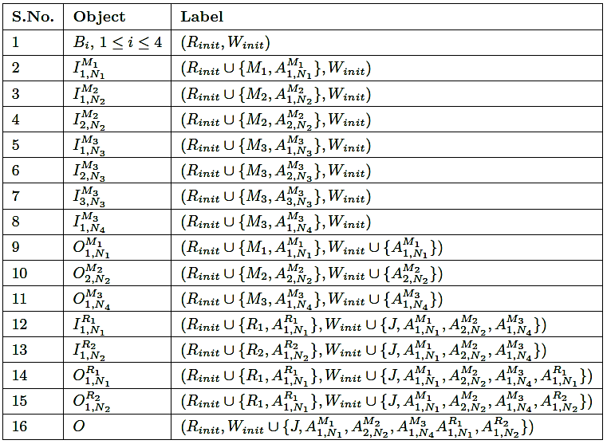
Labels for Example Configuration
RKS and NV Kumar, 2016)

Slide 76
Security Properties Assured by the Labelling
Privacy Invariance: security and privacy reqs on the inputs are maintained as an invariant throughout the computation including the intermediate data that is produced in the process

Slide 77
Security Properties Assured by the Labelling
Protection from Malware: map and reduce are provided by the user and may be malicious, yet the attempt executing these tasks cannot access any data on the node other than the data provided as its input

Slide 78
Security Properties Assured by the Labelling
Non-interference Free Execution: the attempts (could be of tasks of the same job or not) executing simultaneously on a give node are isolated due to labelling, and therefore cannot interfere with one another

Slide 79
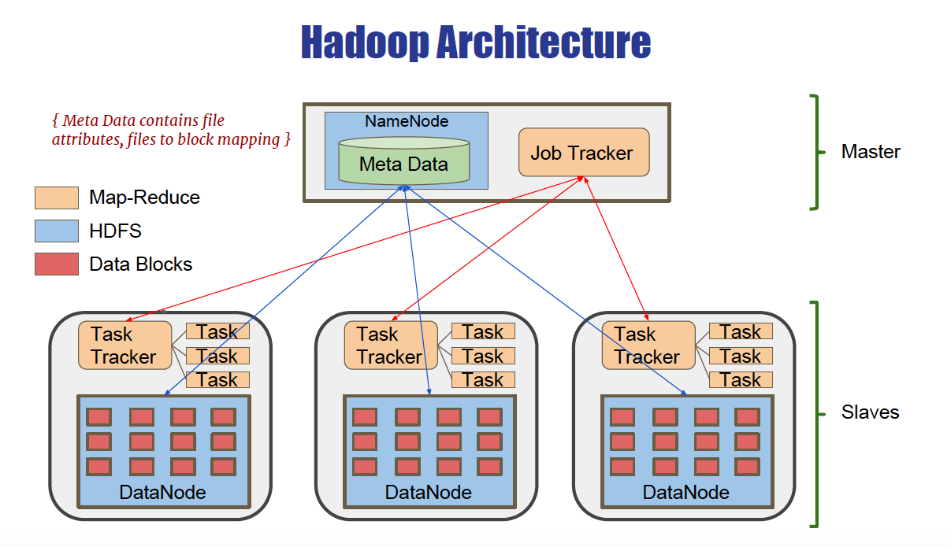
Hadoop source is huge and complex which consists of 2.3 MLOC

Slide 80
Challenges in Implementation
CRUX
Build an RWFM monitor to control the information flow
Integrate DAC of HADOOP with the Information Flow labels of RWFM
Hadoop: Distributed Computing Infrastructure for Big Data Computations
Hadoop Modules:
Hadoop Distributed File System (HDFS)
  Stores user data in files and provides redundancy for high availability.
MapReduce Framework
  Processes problems parallely on large data sets with large number of nodes.
  Prefers locality of data, minimizes network congestion, increases overall throughput.
  Advantages : Scalability, Fault Tolerance
Identify possible points of leakage in the Hadoop System

Slide 81
Performance Results
Comparison between the performance of Classical Hadoop and SecHadoop by increasing input file size
Performance overhead of SecHadoop is 2-5% more in comparison to Classical

Slide 82
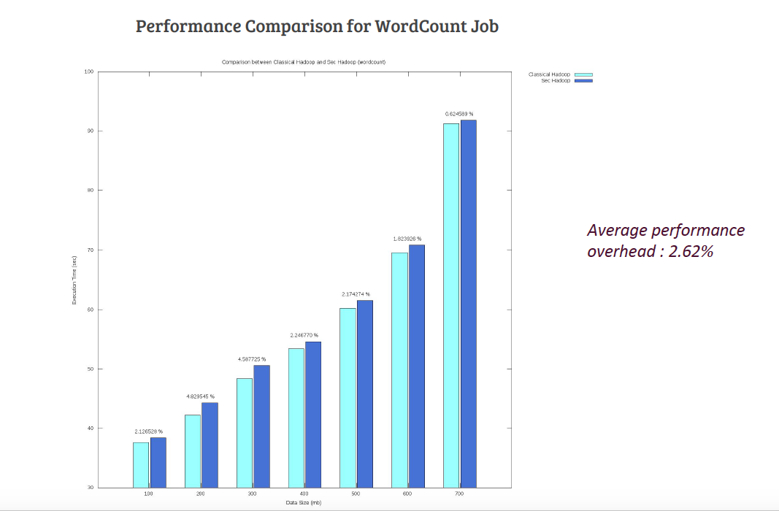

Slide 83
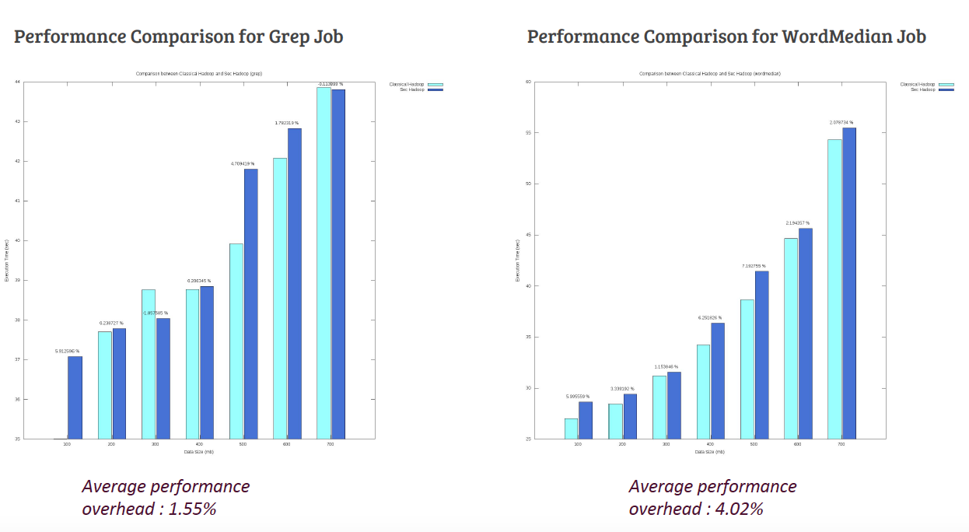

Slide 84
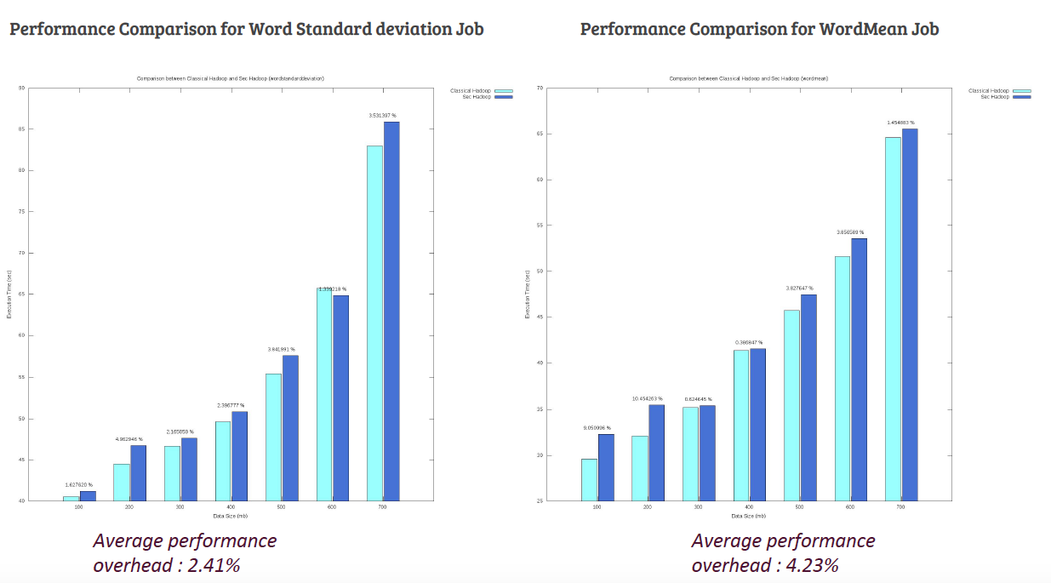

Slide 85
Differential Privacy
No need to use Differential Privacy which depends on noise introduction ( hence difficult for evolving data) and other issues of privacy violation

Slide 86
Ease of Use
Labels of initial objects (data) need to be provided for specifying the security and privacy requirements
Zero-changes to the programming model – jar files for map and reduce
Zero-overhead in terms of system usage – job submission and configurations
Negligible performance overhead

Slide 87
Summary
Preserves Privacy end-to-end
Applicable for merging databases ( for desensitization)
Very Little Overhead
Avoids “noises” required in differential privacy and also applicable for dynamic data

Slide 88
Ongoing work for Medical Data Sharing
Medical wisdom: Realized through a large number of experiments by a multiple parties. In the creation of such datasets, two properties are vital:
Privacy: very important as the medical information of the patient needs to be kept private by the individual and can be used for the purpose treatment and possible to gather data ( or warnings) for the community.
provenance. important for re-constructing intermediate results or new experiments from intermediate ones and ownerships ( IPRs)
For time, we need to integrated Attribute access control as well.

Slide 89
Another Plus Point: Orange Book Standard
Trusted Computer System Evaluation Criteria universally known as “the Orange Book”.
B1 – Labeled Security Protection: the system must implement the Mandatory Access Control in which every subject and object of the system must maintain a security label, and every access to system resource (objects) by a subject must check for security labels and follow some defined rules.

Slide 90
Thank You

